Slide 1


Milton Keynes Problem Gambling Review
DRAFT
Emmeline Watkins

Slide 2
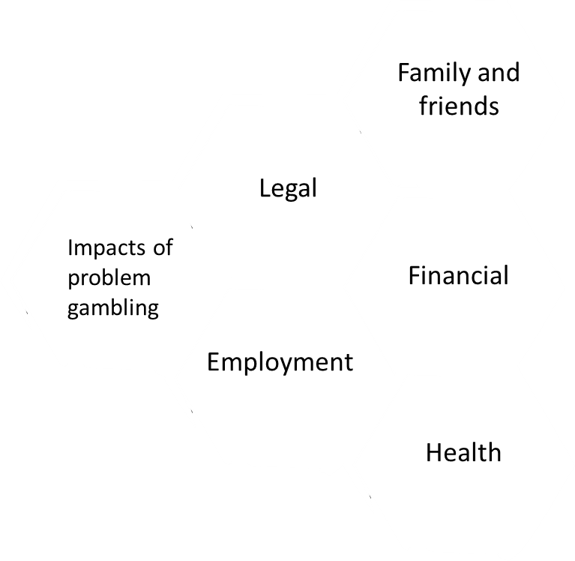
Problem Gambling
“Problem gambling, an excessive gambling behaviour that causes harm to the individual, their family and friends or to the wider community”
Vulnerable Groups
Children and young people
Ethnic minority groups
Residents of low deprivation areas
Unemployed/ homeless
Those on low income
Offender/ ex offenders
Adults with substance misuse issues
Adults with mental health disorders
Poorer intellectual functioning and learning disabilities

Slide 3
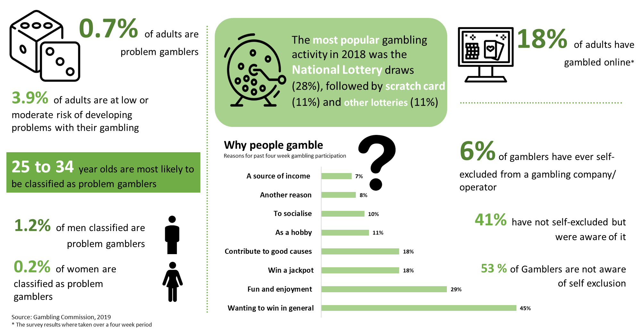

Adults – national data
No overall
political control
£730m budget
Second largest local employer
Robust financial position despite rising demand for services
Adults

Slide 4
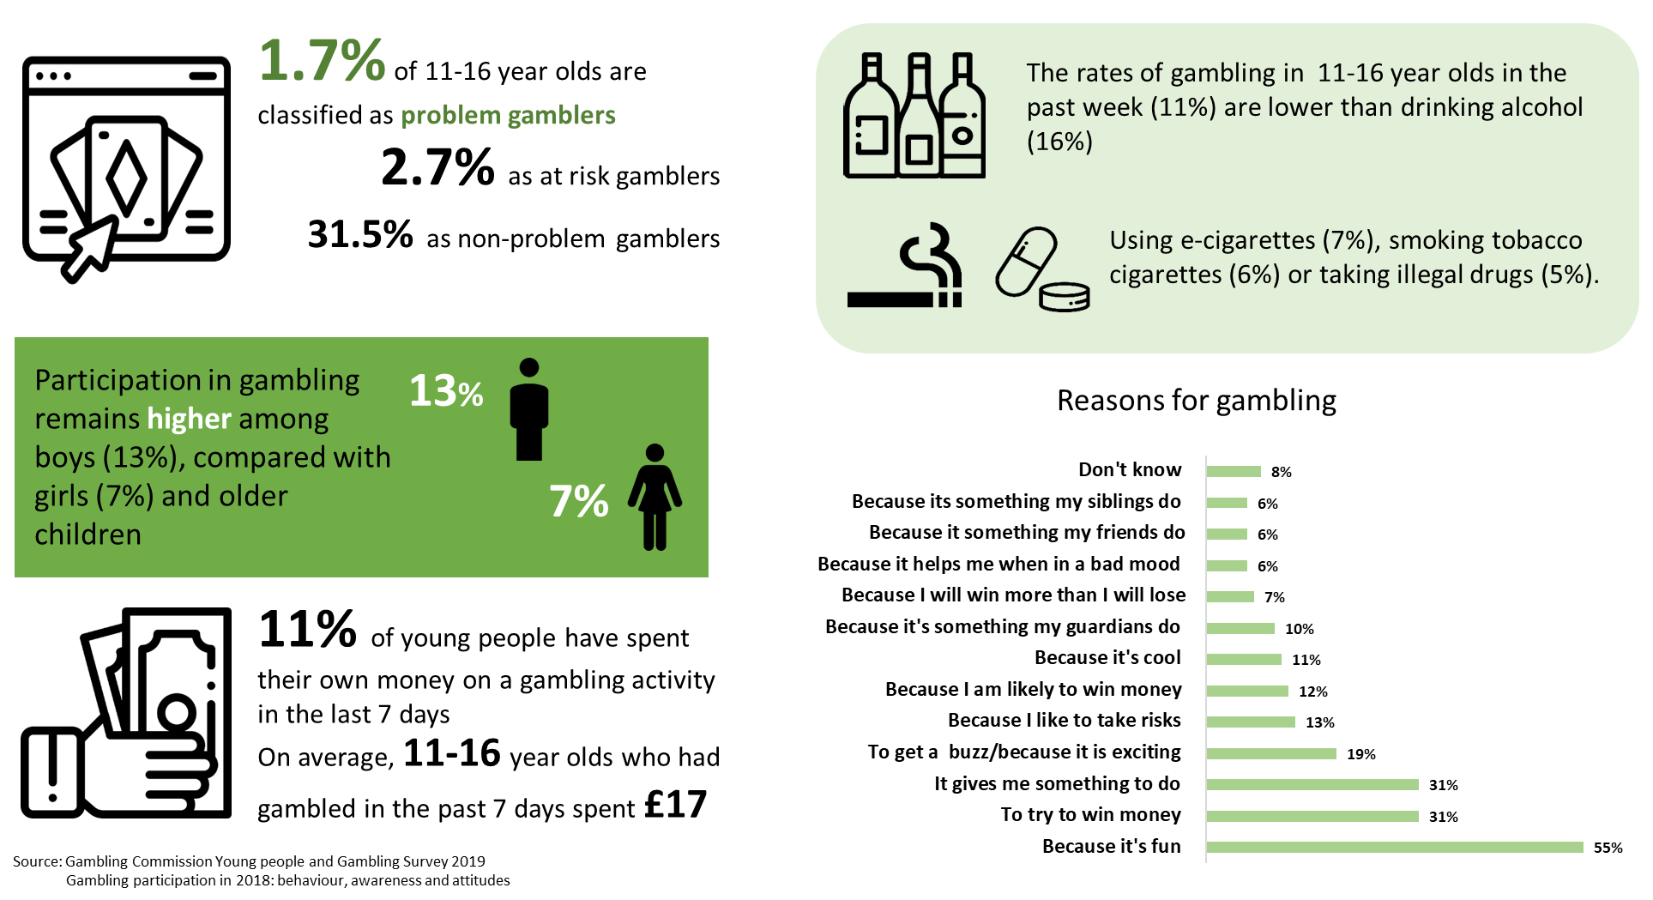
Young people – national data
No overall
political control
£730m budget
Second largest local employer
Robust financial position despite rising demand for services
Children

Slide 5
Milton Keynes Gambling Profile
Location | Machines | Premises | Total
Milton Keynes | 121 | 34 | 155
Central Milton Keynes | 14 | 7 | 21
Bletchley Park | 10 | 9 | 19
Wolverton | 12 | 5 | 17
Newport Pagnell South | 11 | 2 | 13
Newport Pagnell North & Hanslope | 9 | 2 | 11
Bletchley East | 9 | 1 | 10
Stony Stratford | 9 | 1 | 10
Broughton | 6 | 1 | 7
Olney | 6 |  | 6
Bradwell | 5 |  | 5
Campbell Park & Old Woughton | 5 |  | 5
Monkston | 4 | 1 | 5
Stantonbury | 4 | 1 | 5
Danesborough & Walton | 4 |  | 4
Loughton & Shenley | 3 | 1 | 4
Shenley Brook End | 4 |  | 4
Bletchley West | 2 | 1 | 3
Tattenhoe | 2 | 1 | 3
Woughton & Fishermead | 2 | 1 | 3
There are 121 gambling machines and 34 gambling premises in Milton Keynes.
This includes 7 adult gaming centres, 25 betting premises, 1 casino and 1 bingo centre.
A majority of these premises are located within the wards of Bletchley Park (9), Central Milton Keynes (7) and Wolverton (5).
There may be 1,446 people (aged 16 and over) who have a problem with gambling.
Notes:
Extrapolating from national estimates (0.7%) to the Milton Keynes population, there may be 1,446 people (aged 16 and over) who have a problem with gambling. In addition, they may be 2,272 people (aged 16 and over) at moderate risk and 4,957 at low risk of developing gambling related harm in Milton Keynes. The Milton Keynes estimates were calculated from the 2018, 16 and over mid-year population estimates (206,562) and the problem gambling rates from the gambling commission national survey.

Slide 6
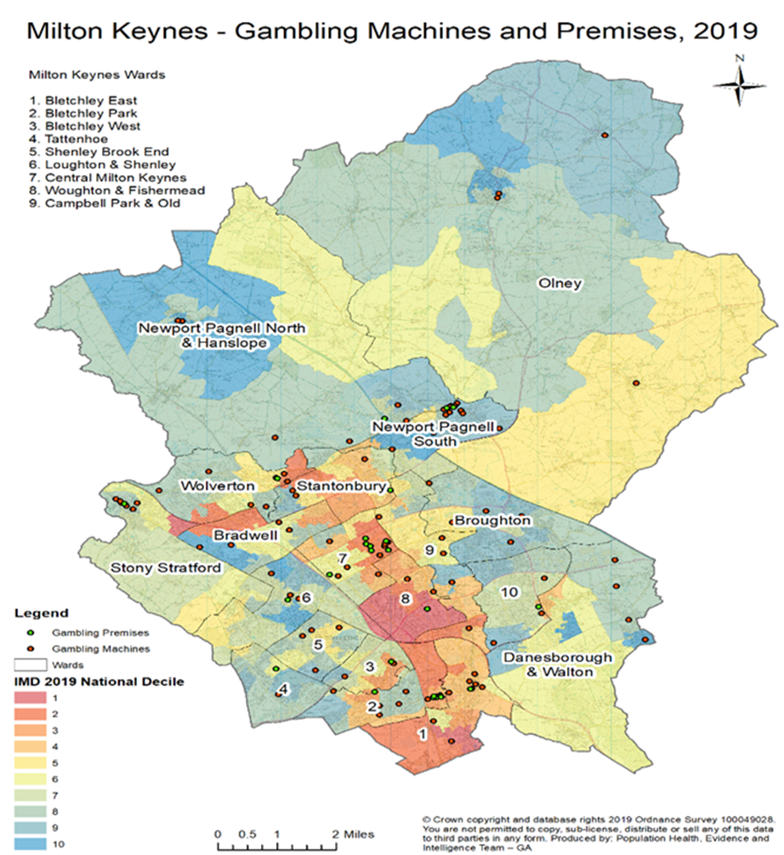
Gambling in Milton Keynes IMD
Over half of gambling premises (53%) within Milton Keynes are located in the two most deprived deciles of the local authority.
Gambling machine locations appear less correlated with deprivation.
26 of the licence locations are in deciles one to five (more deprived)
8 in deciles six to ten (less deprived).
Milton Keynes has a higher number of areas that are categorised as ‘less deprived’ than ‘more deprived’ meaning that the proportional difference is greater.

Slide 7
Milton Keynes Survey
A survey was conducted establish how many organisations in Milton Keynes are equipped to identify, treat or refer problem gamblers.
There were 11 questions in the gambling survey with Yes, No, Likert scale and free text answer options.
27 local organisations were identified by name and were grouped as ; local authority (2), health sector(10), criminal justice (4), third sector(8), other public sector and commissioned (1) and 2 other services (2).

Slide 8
Results
Training
5 in 31 respondents had received any information or training in the 12 months .
Only 2 out of 30 respondents had conducted any problem gambling public awareness and prevention activities

Slide 9
Results
Identify
17 out of 30 of respondents indicated they asked about gambling habits.
No respondents used a recognised screening tool to identify and/or assess the severity of problem gambling.
16 respondents answered “sometimes” and 10 respondents “rarely”, none of the respondents answered “always”.

Slide 10
Results
Refer and Treat
13 out of 27 respondents knew where to refer problem gamblers. The most frequently mentioned providers were Citizen Advice Bureau (4 respondents) Gamblers Anonymous (3 respondents) and Gamcare (3 respondents).
Only 1 respondent said they would refer to IAPT, the commissioned provider for is a free, confidential NHS mental health service
10 out of 30 respondents offer treatment for problem gambling.
Most of the positive (yes) responses where from GP/Health services (6).

Slide 11
Results
Data collection
Only 3 out of 26 organisations collect data on problem gambling.

Slide 12
Summary
• Over half (17 out of 30) of respondent organisations ask about problems with gambling, however problem gambling can be missed or undiagnosed within service users.
• Many organisations/services have not had recent training on identifying problem gambling with 5 out of 31 respondent organisations have received training in the last 12 months.
• There isn’t clarity on support or referral pathways in Milton Keynes. Despite problem gambling “sometimes” featuring in service users of 16 out of 30 respondent organisations only 13 out of 27 organisations knew where to refer problem gamblers. The top three providers stated where Citizen Advice Bureau (4), Gamblers anonymous (3) and Gamcare support service (3).
•10 out of 30 organisations/services stated that they offer treatment to problem gamblers. Six GPs highlighted that they offered treatment. The other organisations were CNWL, xenzone (Kooth), YIS Youth counselling and MIND BLMK
• Most organisations do not collect data on problem gambling

Slide 13
Future plans
Use this slide if you need larger space for infographics or images
About MKC

