Slide 1
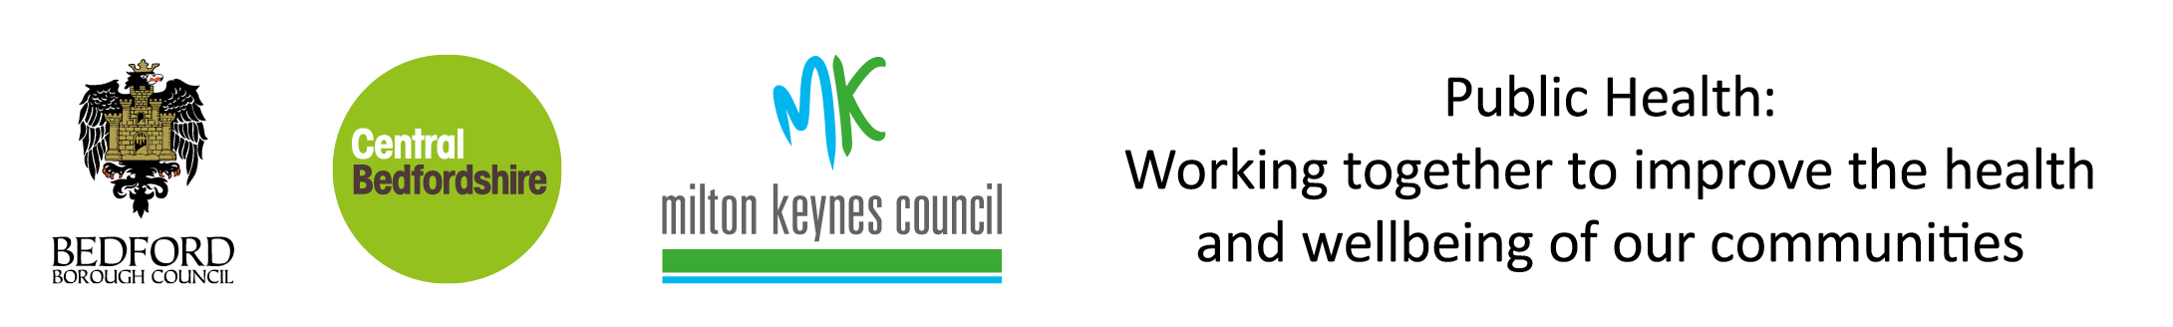
The English Index of Multiple Deprivation 2019
Milton Keynes Council
The English Index of Multiple Deprivation 2019
Milton Keynes Summary
Produced by
Population Health, Evidence & Intelligence
October 2019

Slide 2
The English Index of Multiple Deprivation 2019
Milton Keynes Summary
Introduction
The Index of Multiple Deprivation (IMD) is the official measure of relative deprivation in England and is part of a series of outputs making up the English Indices of Deprivation (IoD). IoD 2019 was published on 26th September 2019 and replaces the 2015 version. This briefing presents the headline IMD findings from the 2019 publication. The English IoD are published by the Ministry of Housing, Communities & Local Government.
The IoD brings together 39 indicators into seven distinct domains of deprivation covering income, employment, education, health, crime, housing and environment. These are grouped further into the Index of Multiple Deprivation. The IMD is an overall measure of multiple deprivation experienced by people living in an area and is calculated for every Lower-layer Super Output Area (LSOA), or neighbourhood, in England. All neighbourhoods in England are ranked according to their level of deprivation relative to other areas. Average IMD measures are available at local authority level.
Key Findings for Milton Keynes
Milton Keynes ranks 107 out of 151 upper tier and unitary local authorities (where 1 is most deprived) and 172 out of 317 lower tier and unitary local authorities. These rankings have changed from 106 out of 152 and 164 out of 326 respectively in 2015, indicating that MK now ranks marginally less deprived relative to other local authorities.
18 out of 152 LSOAs in MK are ranked in the most deprived 20% nationally, with 8 among the most deprived 10%. The most deprived LSOAs are Milton Keynes 032A and 023D, which fall within Bletchley East and Woughton & Fishermead wards. Both are ranked in the 3% most deprived areas in England and are relatively more deprived than in 2015.
Compared to the 2015 IMD, the number of LSOAs in the most deprived 20% nationally has fallen from 21 to 18 and the number in the most deprived 10% has fallen from 9 to 8.
Overall, 71 LSOAs rank as less deprived in 2019 than in 2015, and 81 rank as more deprived. While MK overall ranks marginally less deprived in 2019, this masks increasing deprivation in some areas and potentially widening inequalities.
Further information
The full IoD data along with technical details and national summary reports can be found here:
https://www.gov.uk/government/statistics/english-indices-of-deprivation-2019
A helpful visualisation tool of the national results can be found here:
http://dclgapps.communities.gov.uk/imd/iod_index.html

Slide 3
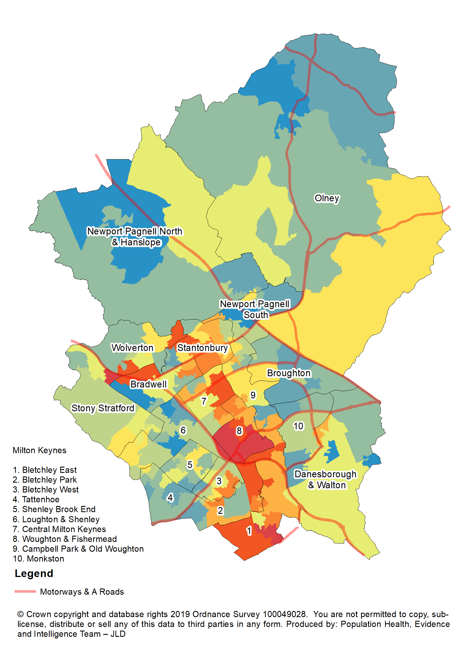
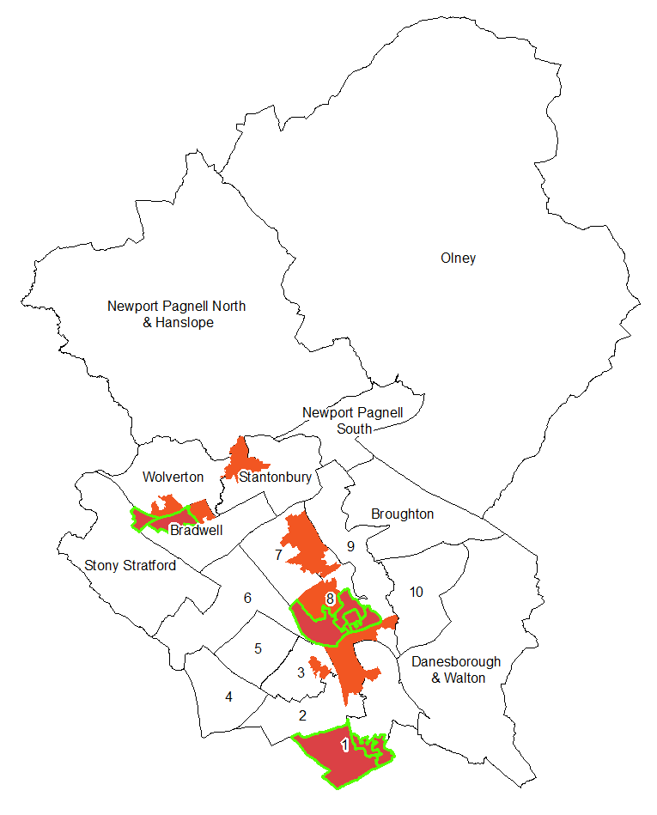

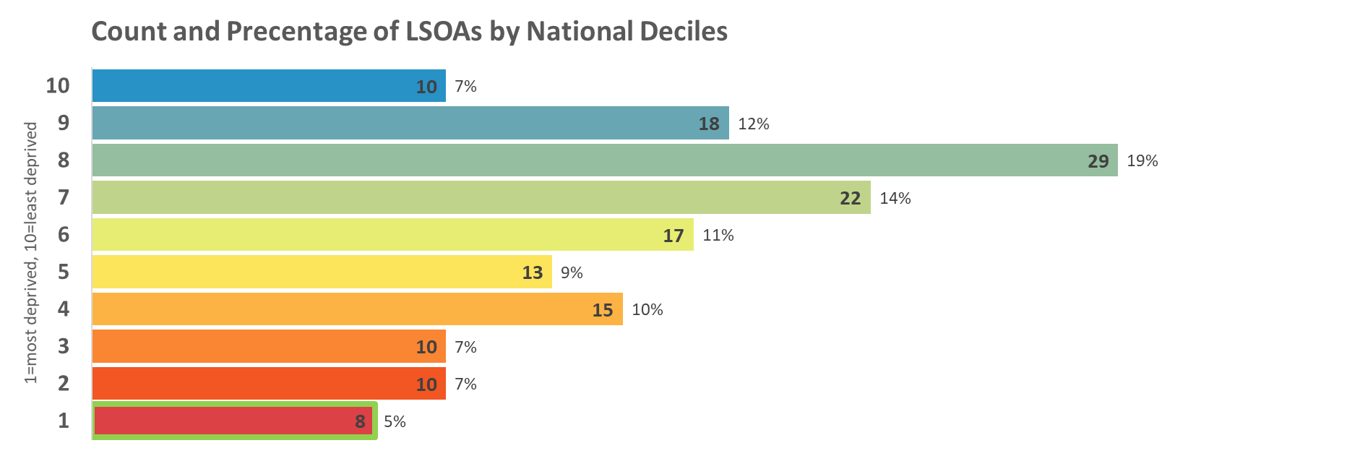
The English Index of Multiple Deprivation 2019
Milton Keynes Summary
Index of Multiple Deprivation
The overall Index of Multiple Deprivation (IMD) is a weighted measure based on information
relating to income, employment, education, health, crime, housing and environment.
Map 1: Distribution of the Index of Multiple Deprivation 2019
Change in areas amongst the most deprived 20% in England
2015
2019
Legend
10% most deprived
20% most deprived

