Slide 1
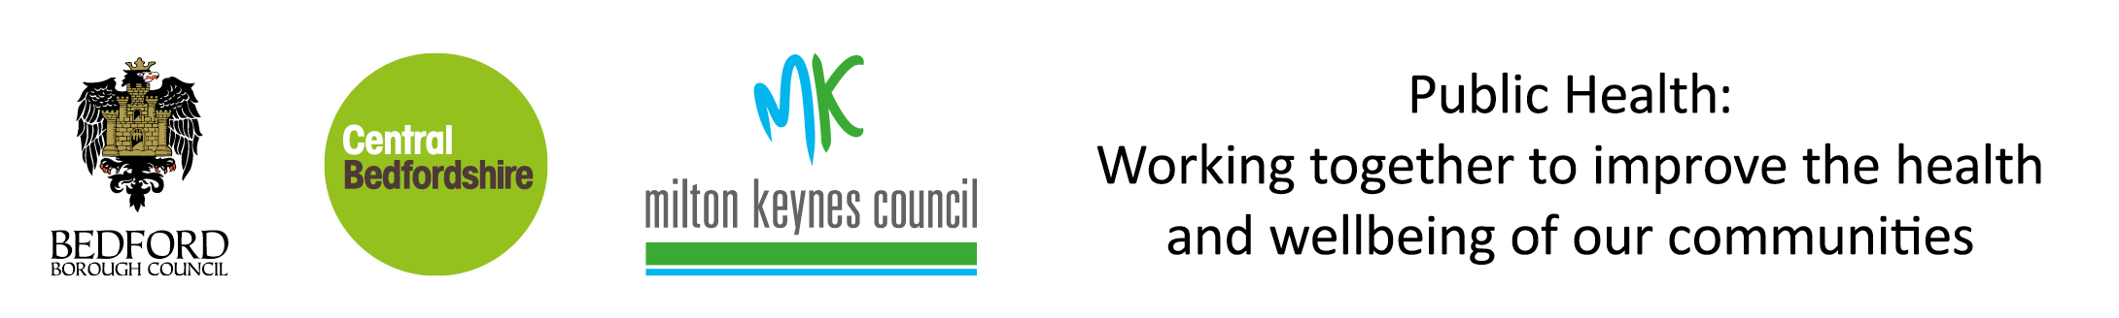
Indices of Deprivation 2019
Milton Keynes Council
Indices of Deprivation 2019
Milton Keynes
Produced by
Population Health, Evidence & Intelligence
January 2020

Slide 2







Indices of Deprivation 2019
Milton Keynes
Introduction
The Index of Multiple Deprivation (IMD) is the official measure of relative deprivation in England and is part of a series of outputs making up the Indices of Deprivation (IoD). This briefing presents the headline findings from IoD 2019 and changes from the 2015 position. IoD combine 39 indicators into seven distinct domains of deprivation covering: income; employment; education; health; crime; housing; and environment(see figure 3). The IoD gives an indication of the extent of different types of deprivation experienced in neighbourhoods (or lower super output areas, LSOAs). All neighbourhoods in England are ranked according to their level of deprivation relative to other areas. Average measures are also available at local authority level.
Overall Deprivation
Milton Keynes (MK) ranks 107/151 upper tier and unitary local authorities (where 1 is most deprived) and 172/317 lower tier and unitary local authorities. 18/152 LSOAs in Milton Keynes are ranked in the most deprived 20% nationally, with 8 among the most deprived 10%. The most deprived wards are Bletchley East and Woughton & Fishermead.
Income
From 2015 to 2019, the number of areas amongst the most deprived 10% and 20% nationally has fallen from 10 to 8 and 23 to 17 respectively. The most deprived areas based on income are Woughton & Fishermead and Bletchley East.
Employment
There has been an increase in the number of areas among the most deprived 10% nationally from 7 to 8 LSOAs, while the number of areas amongst the most deprived 20% has fallen from 19 to 16. The areas which are most deprived are Woughton & Fishermead and Bletchley East.
Income deprivation affecting older people
Between 2015 and 2019 there has been a decrease in the number of areas among the most deprived 20% and 10%, from 13 to 11 and 4 to 3 respectively. The most deprived wards are Woughton & Fishermead, Bletchley East and Tattenhoe.
Income deprivation affecting children
There has been a decrease in the number of areas amongst the most deprived 10% nationally, from 12 to 7, and among the most deprived 20% from 25 to 18. The most deprived wards within Milton Keynes for this are Woughton & Fishermead and Bletchley East.
Education, Skills and Training
There has been an increase in the number of areas amongst the most deprived 10% nationally from 8 to 9 areas, while the number among the top 20% has declined from 23 to 21. The areas that rank amongst the most deprived in the local authority are Stony Stratford and Woughton & Fishermead.
Children and Young People
There has been an increase in the number of areas in Milton Keynes which now rank among the most deprived 10% nationally, from 7 to 10, between 2015 and 2019. There has been a decrease in the number of areas among the most deprived 20%, from 23 to 19 areas. Those areas that rank highest are Woughton & Fishermead and Stony Stratford.
See page 16 for a table that shows the wards that are most deprived in each of the domains.

Slide 3





Indices of Deprivation 2019
Milton Keynes
Crime
The number of areas that are among the 10% most deprived nationally has decreased from 11 to 3, and among the 20% most deprived from 25 to 14 between 2015 and 2019. The most deprived wards for crime are Bletchley Park, Bletchley East, Woughton & Fishermead and Campbell Park and Old Woughton.
Barriers to Housing and Services
There has been an increase in the number of areas that are among the most deprived nationally. Between 2015 to 2019, the number of areas among the most deprived 20% rose from 45 to 77, and among the most deprived 10%, the number rose from 14 to 28. The areas which are the most deprived were Olney, Stony Stratford and Woughton & Fishermead.
Health Deprivation and Disability
There has been a decrease in the number of LSOAs which rank among the most deprived 20% and 10% nationally for health and disability, from 14 to 10 and 6 to 4 respectively. The most deprived areas for health are Woughton & Fishermead and Bletchley East.
Adult Skills
There has been no change in the number of areas among the most deprived 10% and 20% nationally, remaining at 9 and 25 LSOAs respectively. The areas which rank amongst the most deprived are Woughton & Fishermead, Stony Stratford and Bletchley East.
Living Environment
There has been an increase in the areas for living environments that are amongst the most deprived 10% and 20% nationally, from 0 to 1, and 2 to 3 respectively. The most deprived areas for living environment are Newport Pagnell North & Hanslope, Olney, Wolverton and Bradwell.
Figure 1: Change in the number of LSOAs in Milton Keynes which rank in the most deprived 20% and 10% nationally from 2015 to 2019.
Domain | 20% most deprived nationally |  |  | 10% most deprived nationally
 | 2015 | 2019 | % Change | 2015 | 2019 | % Change
Income | 23 | 17 | -6 | 10 | 8 | -2
Income deprivation affecting children | 25 | 18 | -7 | 12 | 7 | -5
Income deprivation affecting older people | 13 | 11 | -2 | 4 | 3 | -1
Employment | 19 | 16 | -3 | 7 | 8 | +1
Education Skills and Training | 23 | 21 | -2 | 8 | 9 | +1
Children and Young People | 23 | 19 | -4 | 7 | 10 | +3
Adult Skills | 25 | 25 | - | 9 | 9 | -
Health Deprivation & Disability | 14 | 10 | -4 | 6 | 4 | -2
Crime | 25 | 14 | -9 | 11 | 3 | -8
Barriers to Housing and Services | 45 | 77 | +32 | 14 | 28 | +14
Living Environment | 2 | 3 | +1 | 0 | 1 | +1

Slide 4
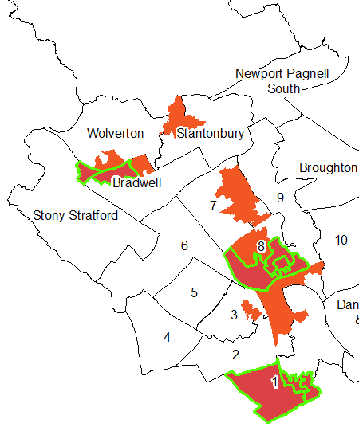

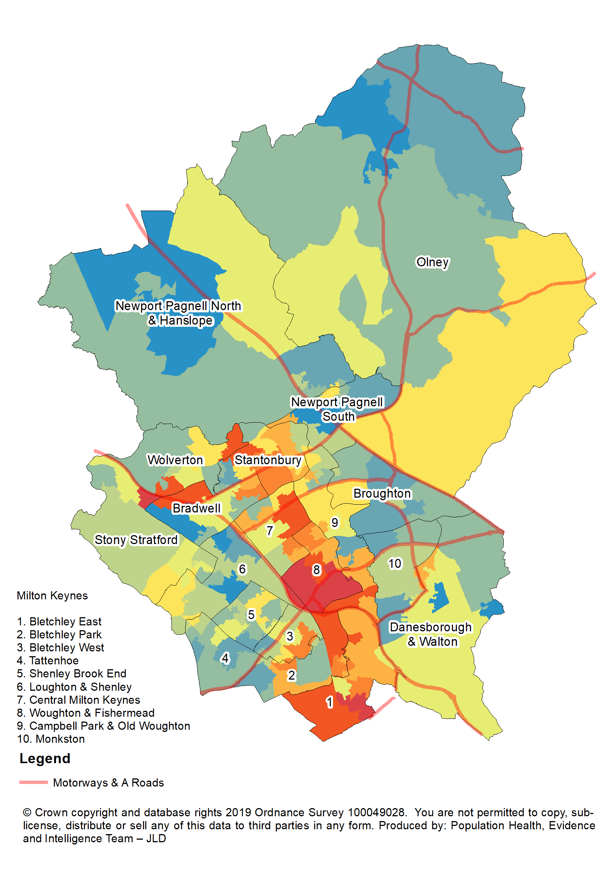
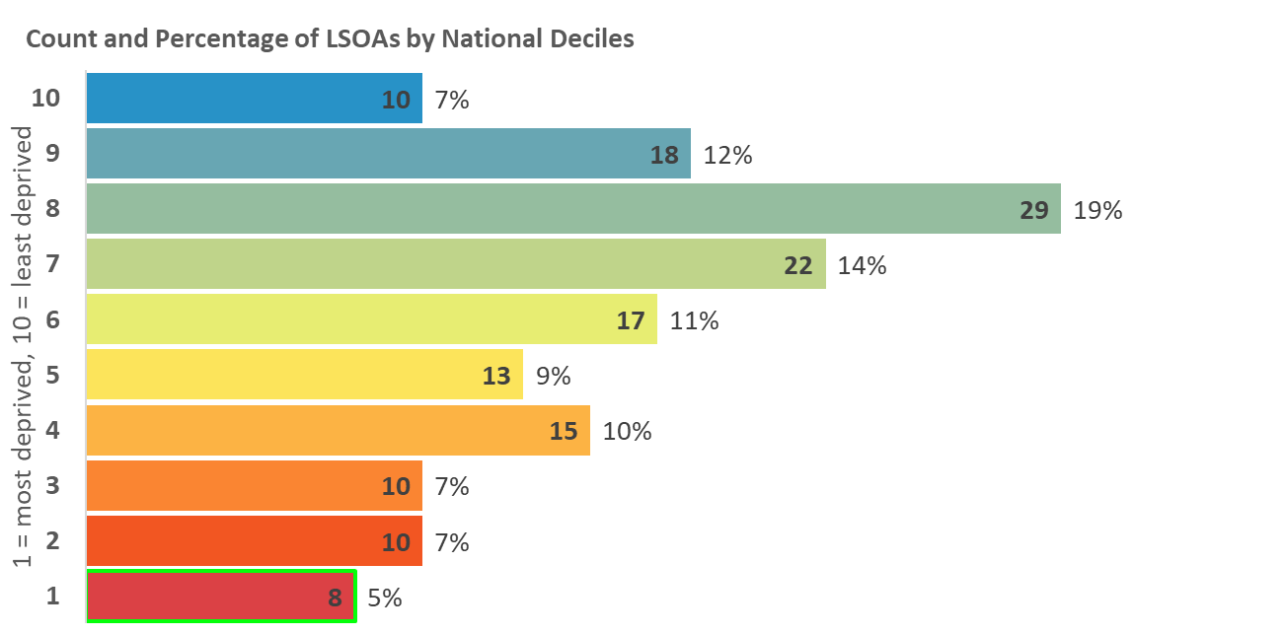
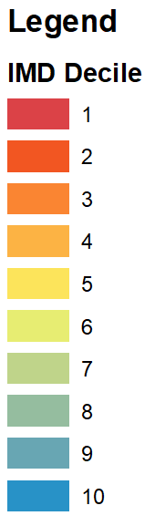
Indices of Deprivation 2019
Milton Keynes
Index of Multiple Deprivation
The overall Index of Multiple Deprivation (IMD) is a weighted measure based on information
relating to income, employment, education, health, crime, housing and environment.
Map 1: Distribution of the Index of Multiple Deprivation 2019
Areas amongst the most deprived 20% in England
2015
2019
Legend
10% most deprived
20% most deprived

Slide 5
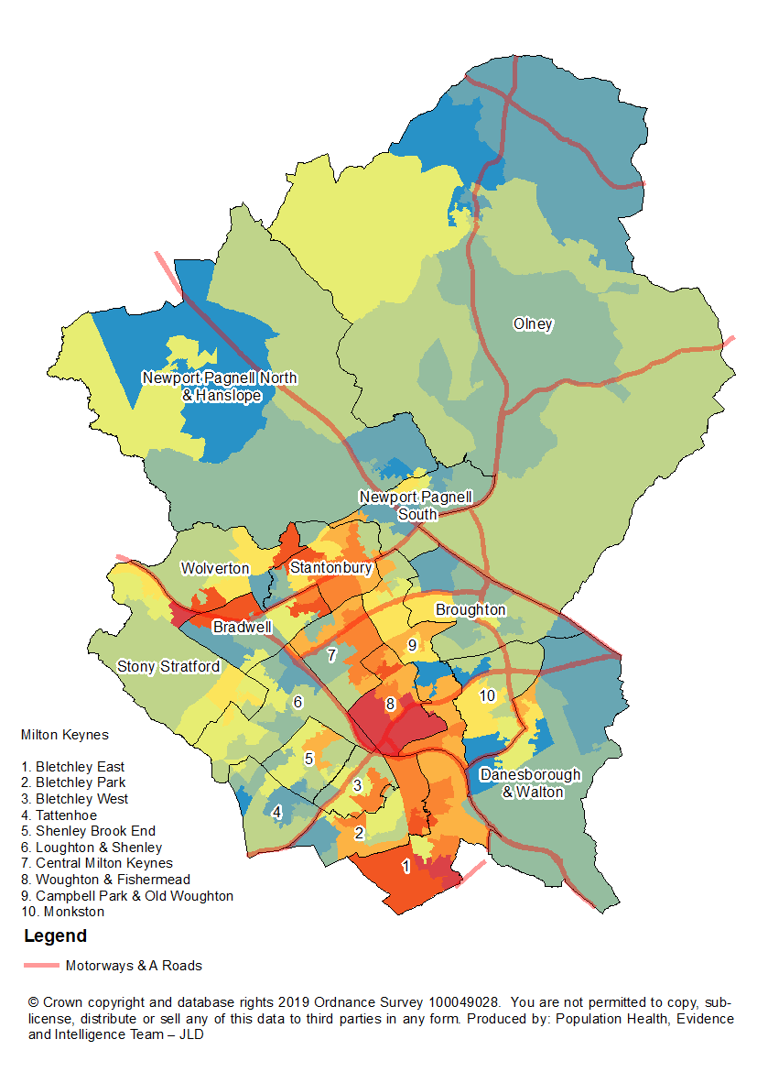
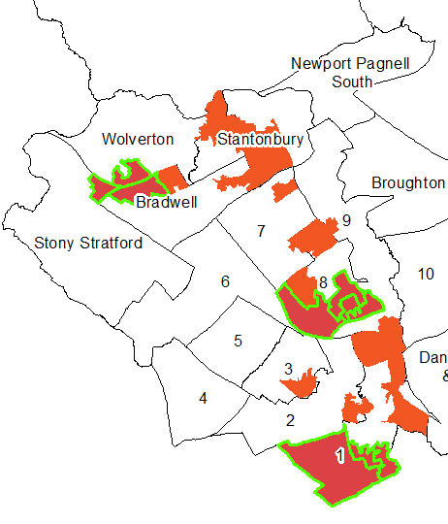
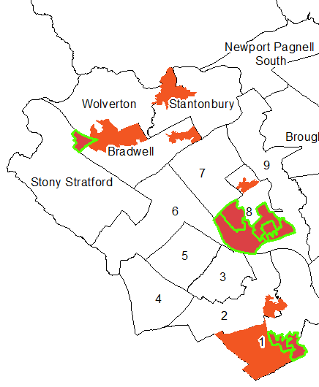
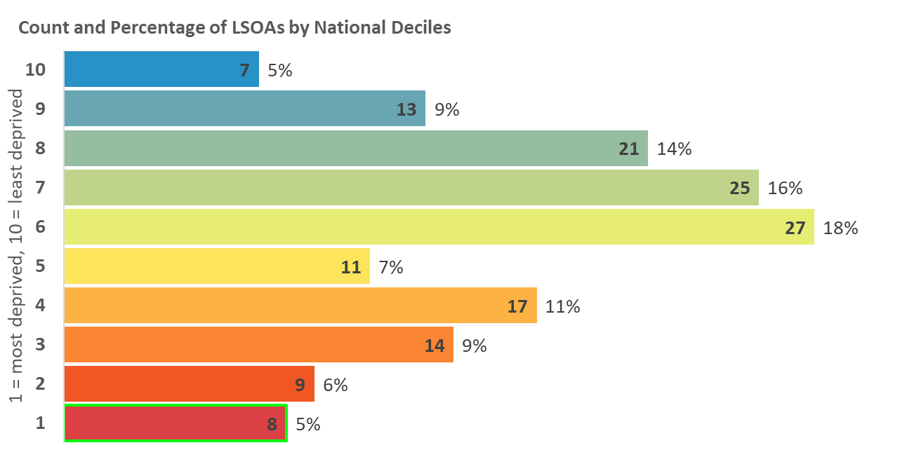
Indices of Deprivation 2019
Milton Keynes
Income Deprivation
The proportion of the population in an area experiencing deprivation relating to low income. Low income includes both those people that are out-of-work, and those in work but have low earnings.
Map 2: Distribution of Income Deprivation 2019
Areas amongst the most deprived 20% in England
2015
2019
Legend
10% most deprived
20% most deprived

Slide 6
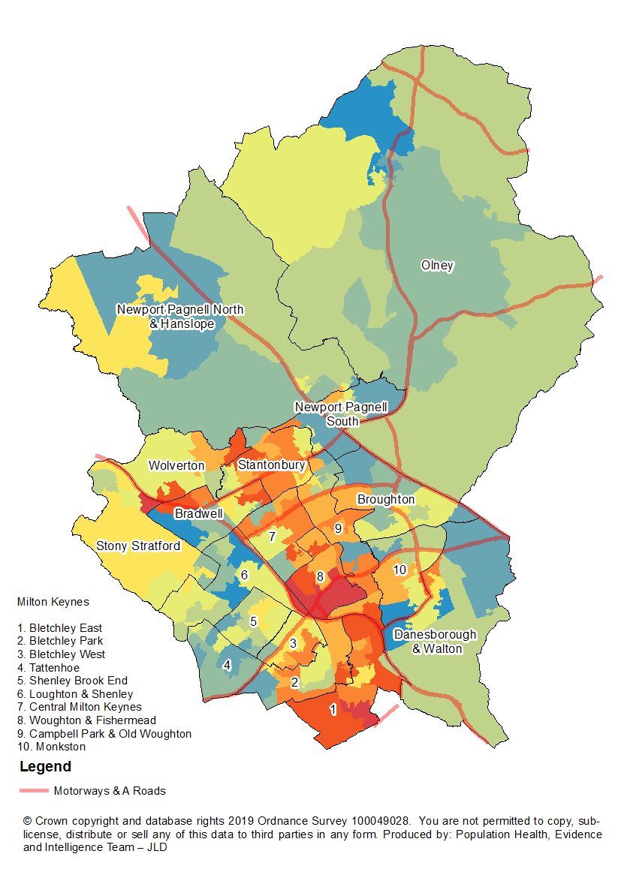
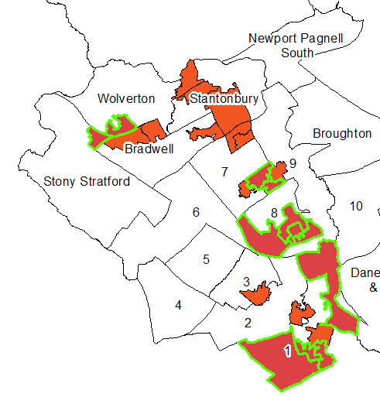
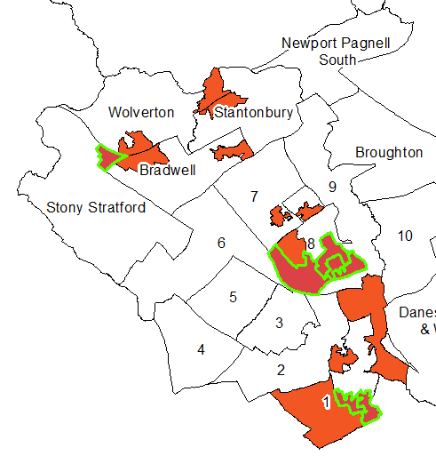
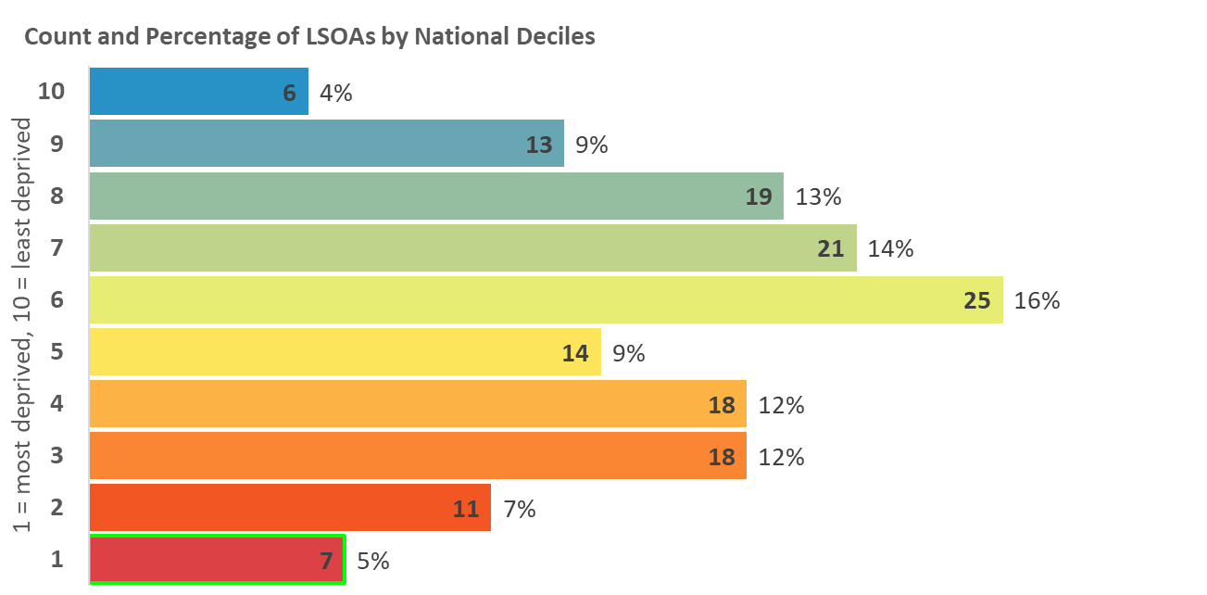
Indices of Deprivation 2019
Milton Keynes
Income Deprivation Affecting
Children Index (IDACI)
A subset of the Income Deprivation Domain. The proportion of children (0-15) in each LSOA that live in families that are income deprived; those that are in receipt of Income Support, income-based Jobseeker’s Allowance, Pension Credit Guarantee or Working/Child Tax Credit below a given threshold.
Map 3: Distribution of IDACI 2019
Areas amongst the most deprived 20% in England
2015
2019
Legend
10% most deprived
20% most deprived

Slide 7
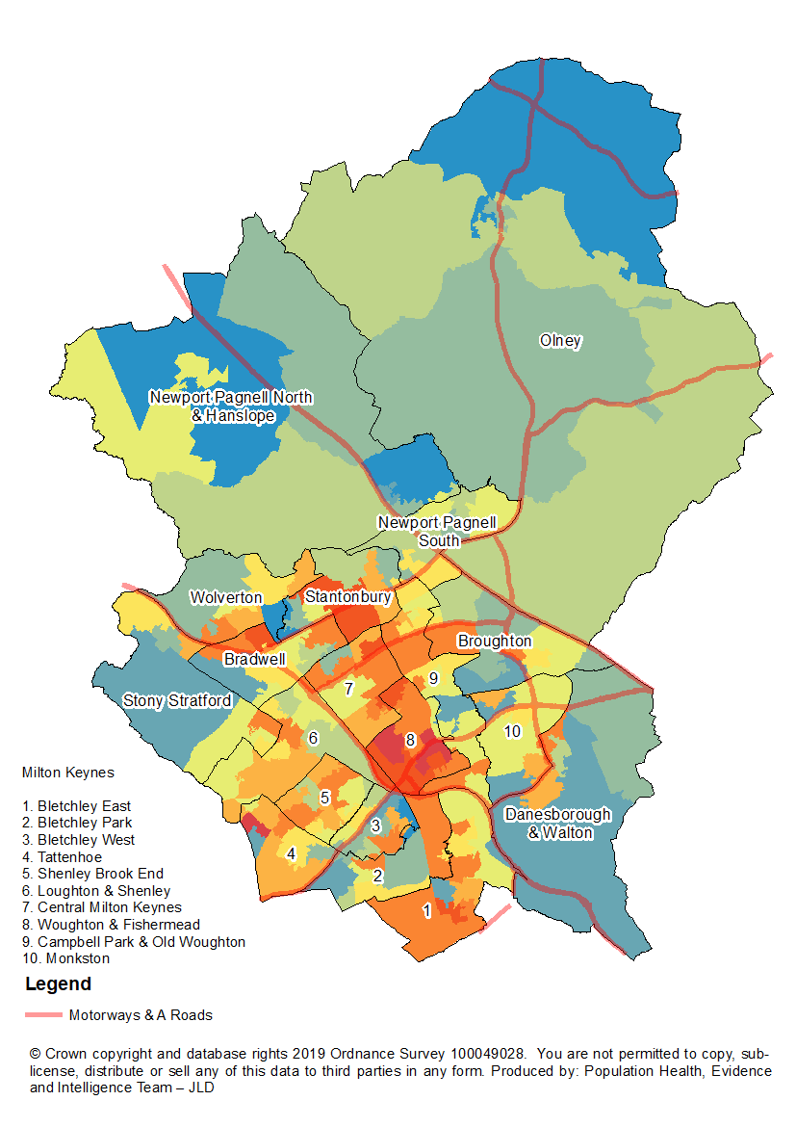
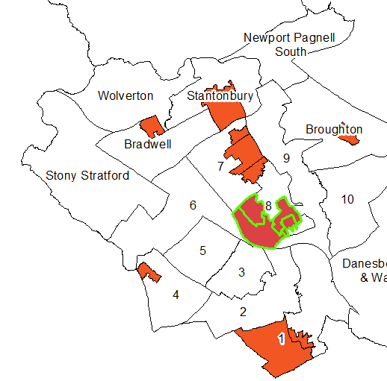
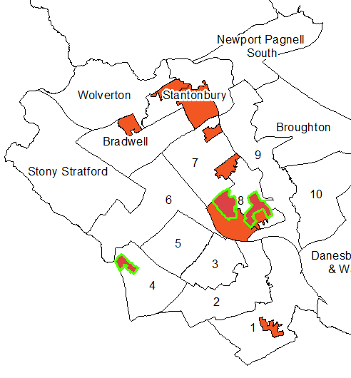
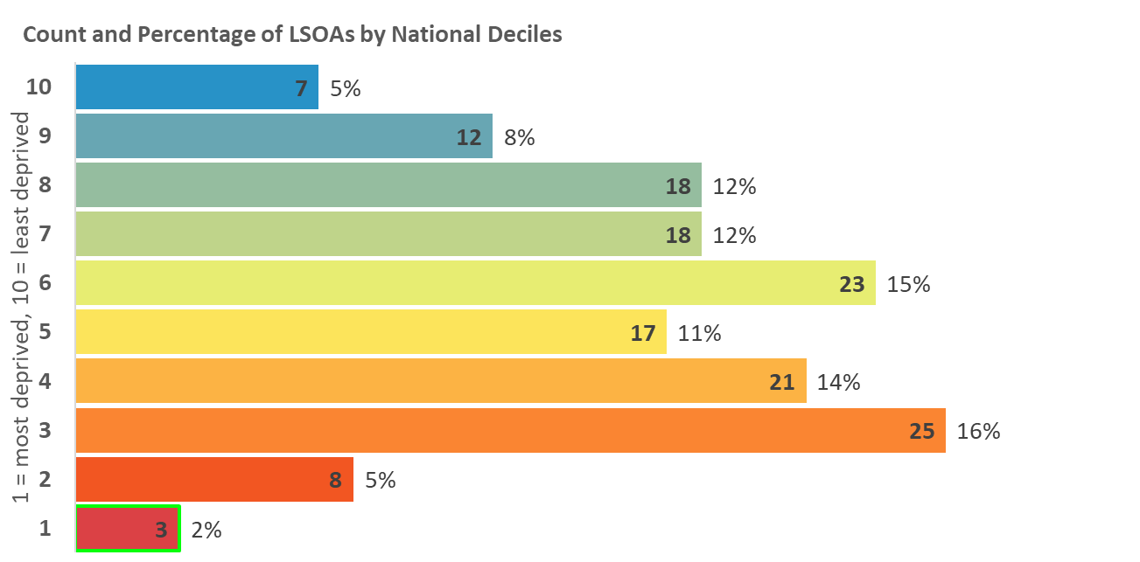
Indices of Deprivation 2019
Milton Keynes
Income Deprivation Affecting
Older People (IDAOPI)
A subset of the Income Deprivation Domain. The proportion of a LSOAs population aged 60 and over receiving Income Support, income-based Jobseekers Allowance, income-based Employment and Support Allowance, or Pension Credit (Guarantee).
Map 4: Distribution of IDAOPI 2019
Areas amongst the most deprived 20% in England
2015
2019
Legend
10% most deprived
20% most deprived

Slide 8
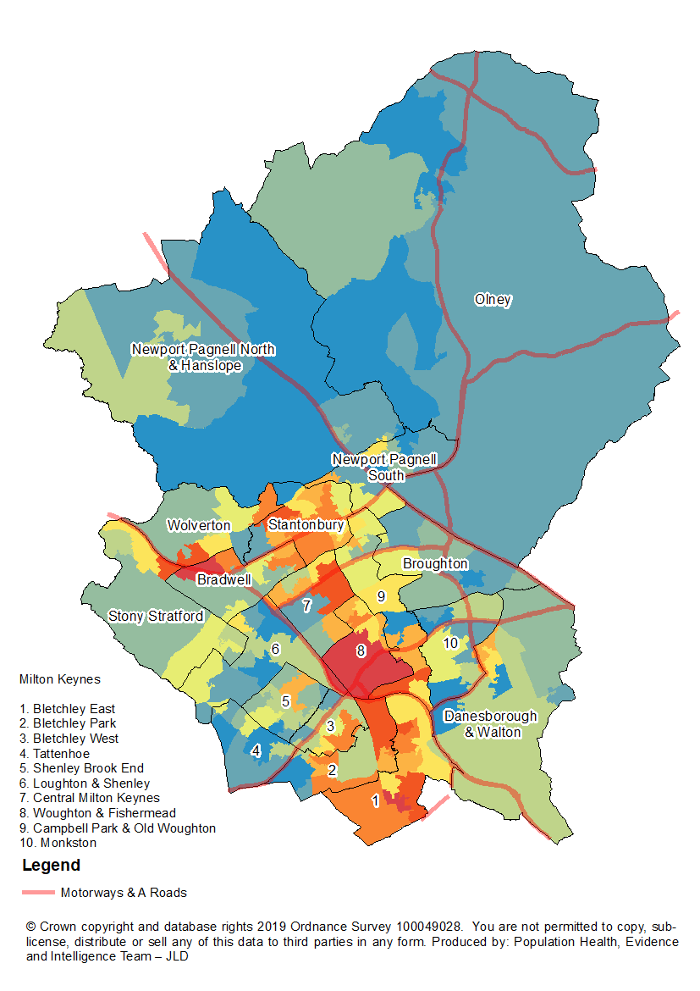
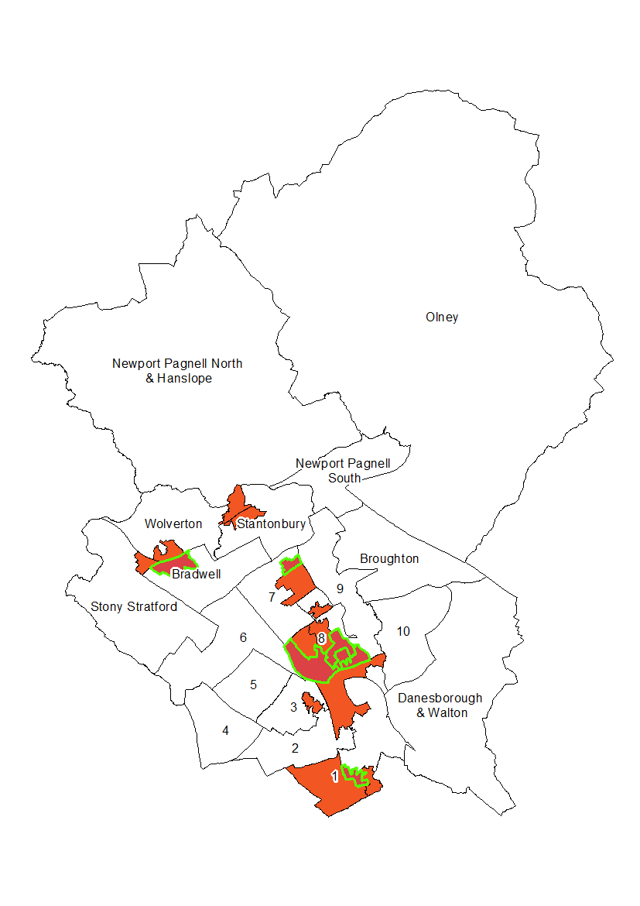
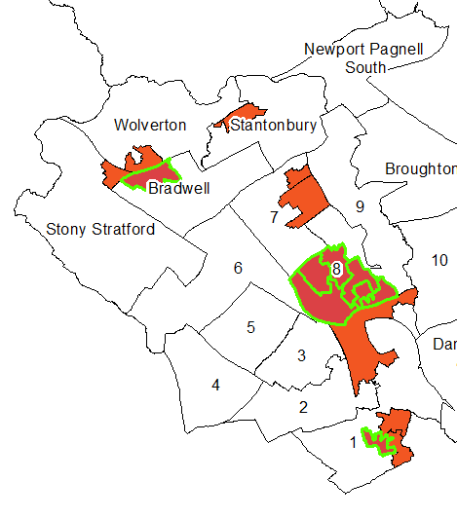
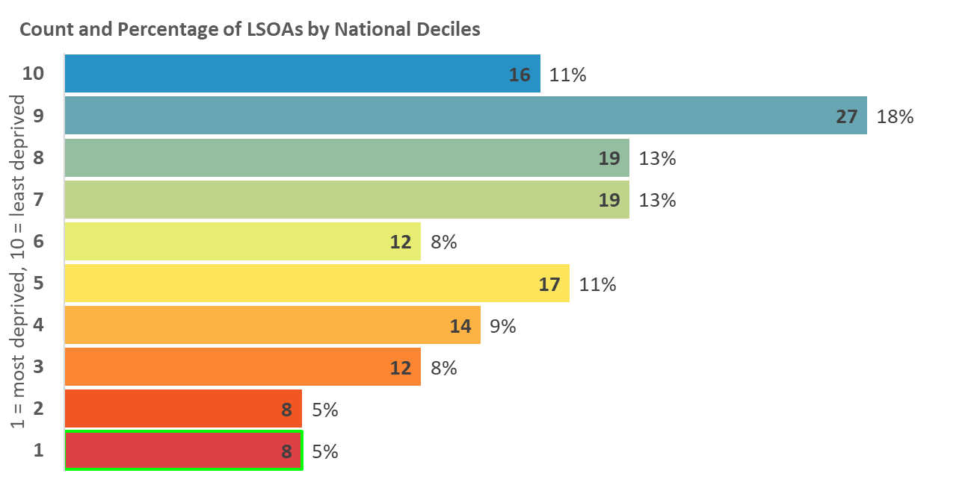
Indices of Deprivation 2019
Milton Keynes
Employment Deprivation
The proportion of the working age population involuntarily excluded from the labour market. Indicators included are claimants of Jobseekers’ Allowance, Employment and Support Allowance, Incapacity Benefit, Severe Disablement Allowance, and Carer’s Allowance.
Map 5: Distribution of Employment Deprivation 2019
Areas amongst the most deprived 20% in England
2015
2019
Legend
10% most deprived
20% most deprived

Slide 9
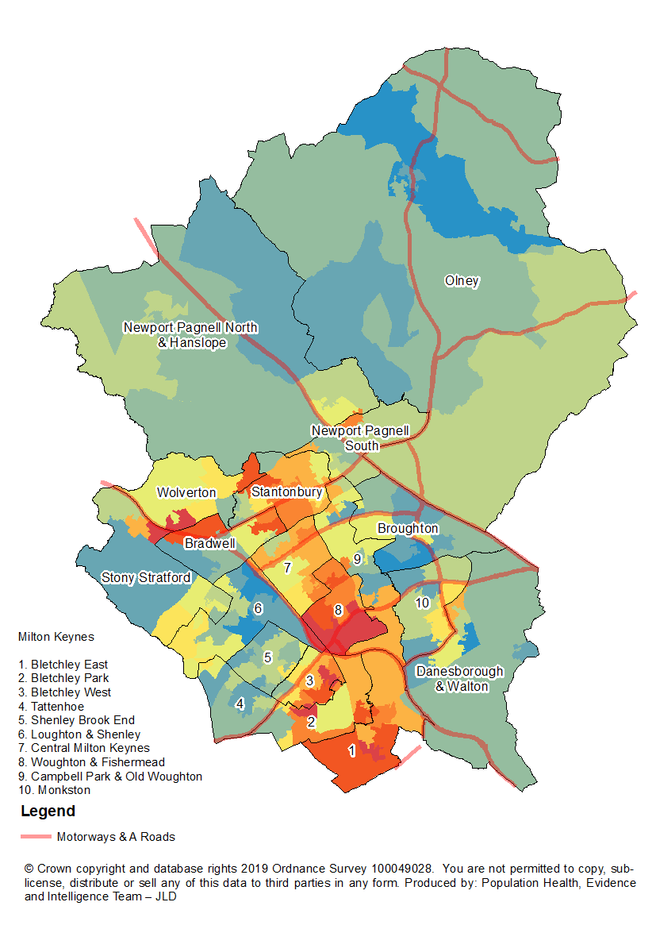
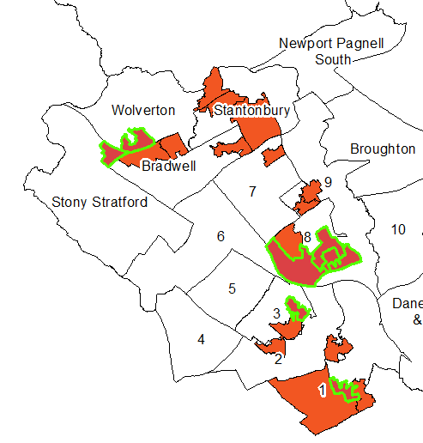
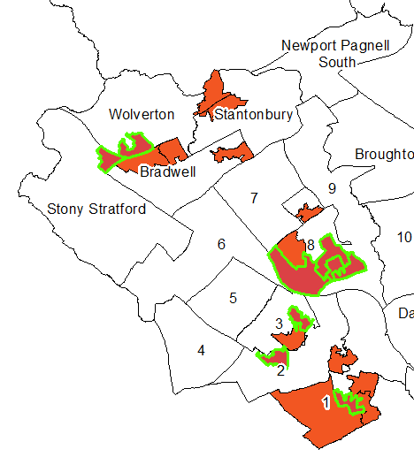
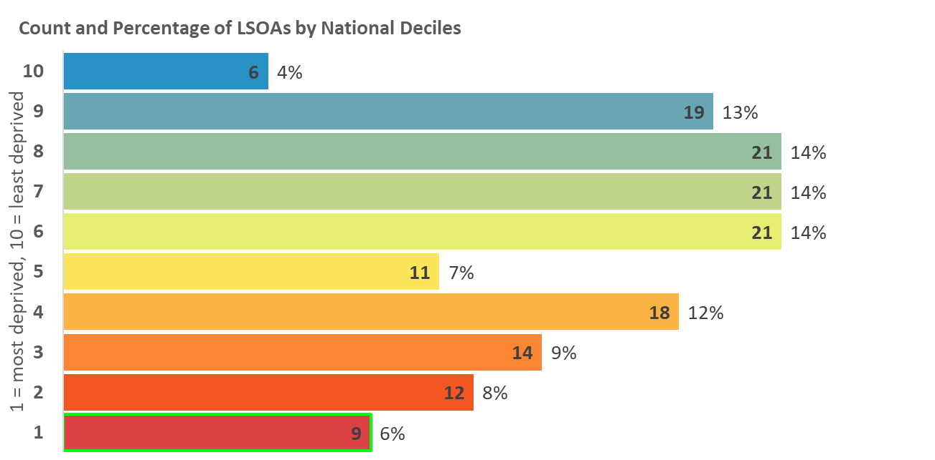
Indices of Deprivation 2019
Milton Keynes
Education, Skills and Training
Deprivation
Measures the lack of attainment and skills in the local population. The indicator is related to two sub-domains: children and young people as well as adult skills. These two sub-domains reflect the ‘flow’ and ‘stock’ of educational disadvantage within an area respectively.
Map 6: Distribution of Education, Skills and Training
Deprivation 2019
Areas amongst the most deprived 20% in England
2015
2019
Legend
10% most deprived
20% most deprived

Slide 10
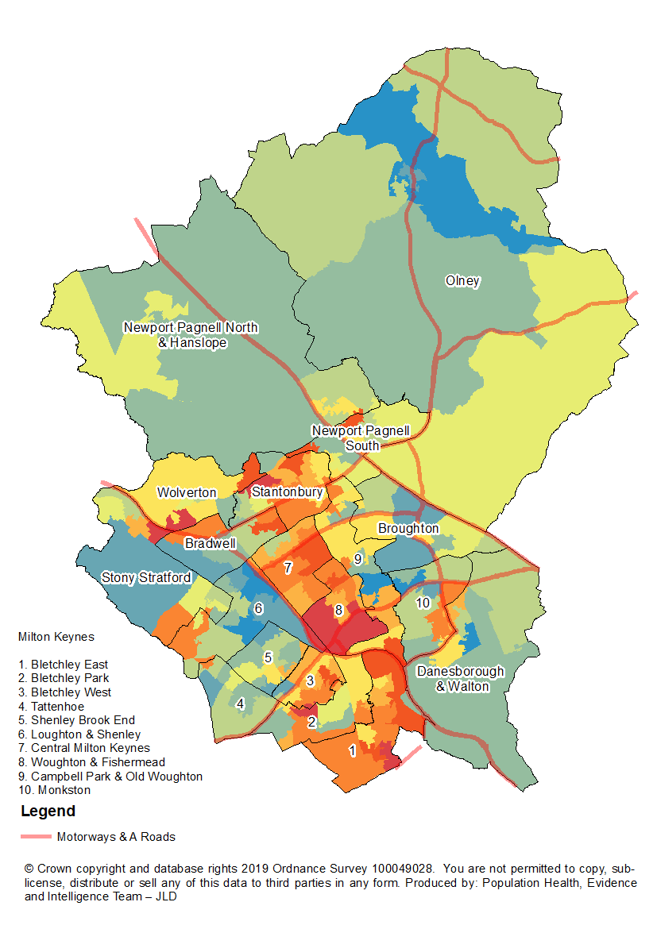
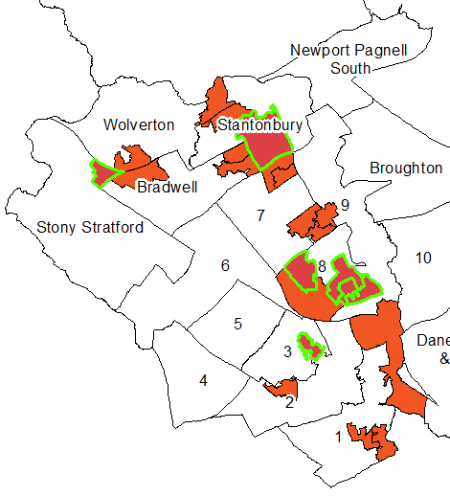
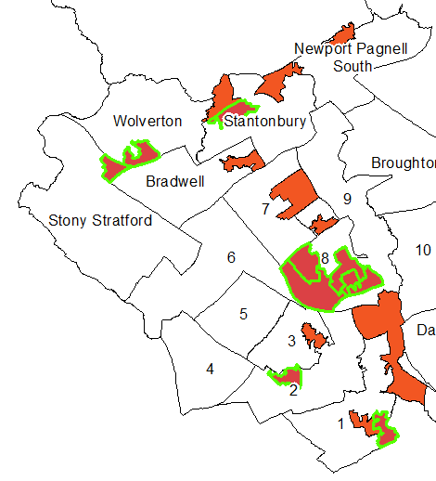
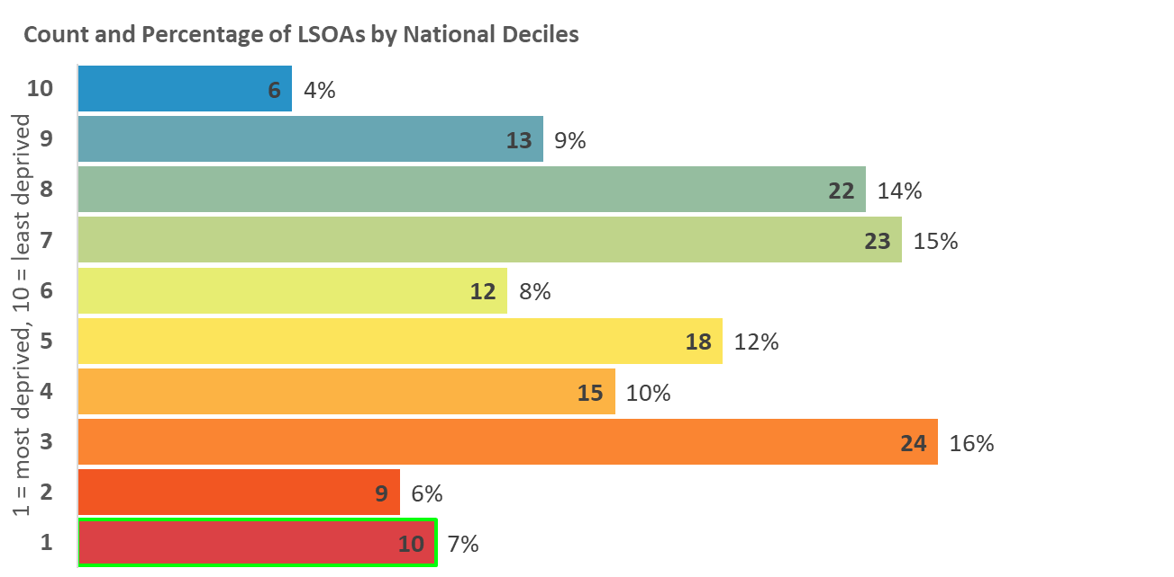
Indices of Deprivation 2019
Milton Keynes
Children and Young People
Deprivation
Measure based on average points score for Key Stage 2 and 4 attainment, proportion of secondary school (authorised and unauthorised) absences, proportion of young people not staying on in education above age 16, and young people aged 21 not entering higher education.
Map 7: Distribution of Children and Young People
Deprivation 2019
Areas amongst the most deprived 20% in England
2015
2019
Legend
10% most deprived
20% most deprived

Slide 11
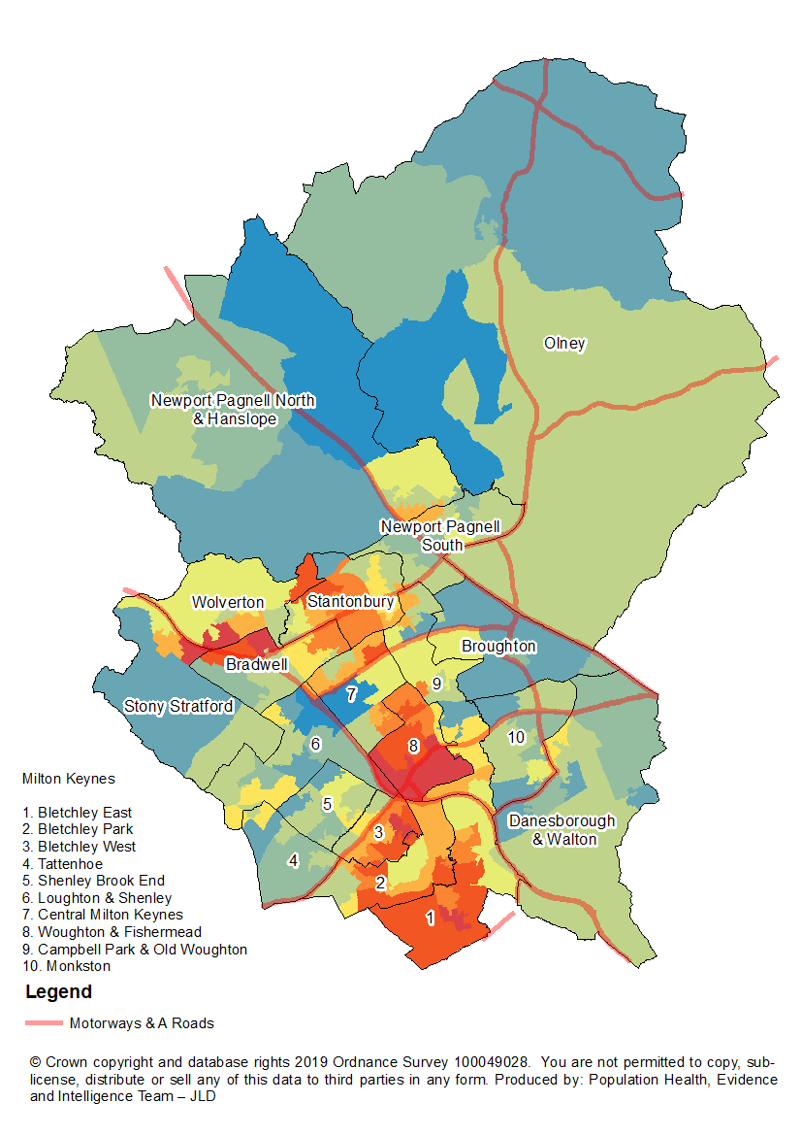
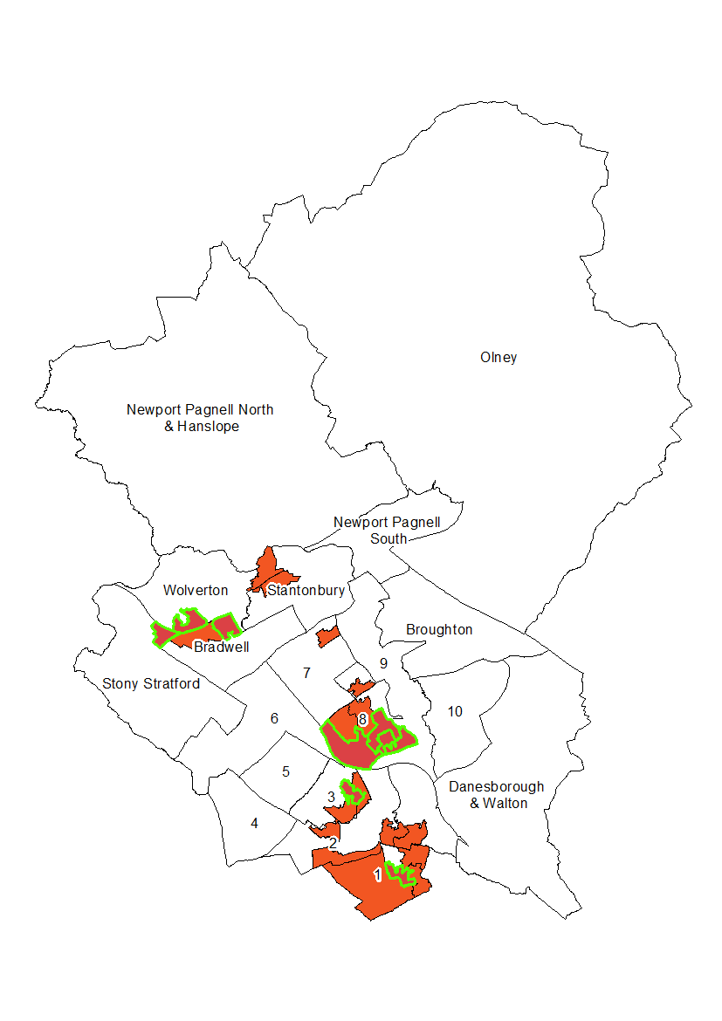
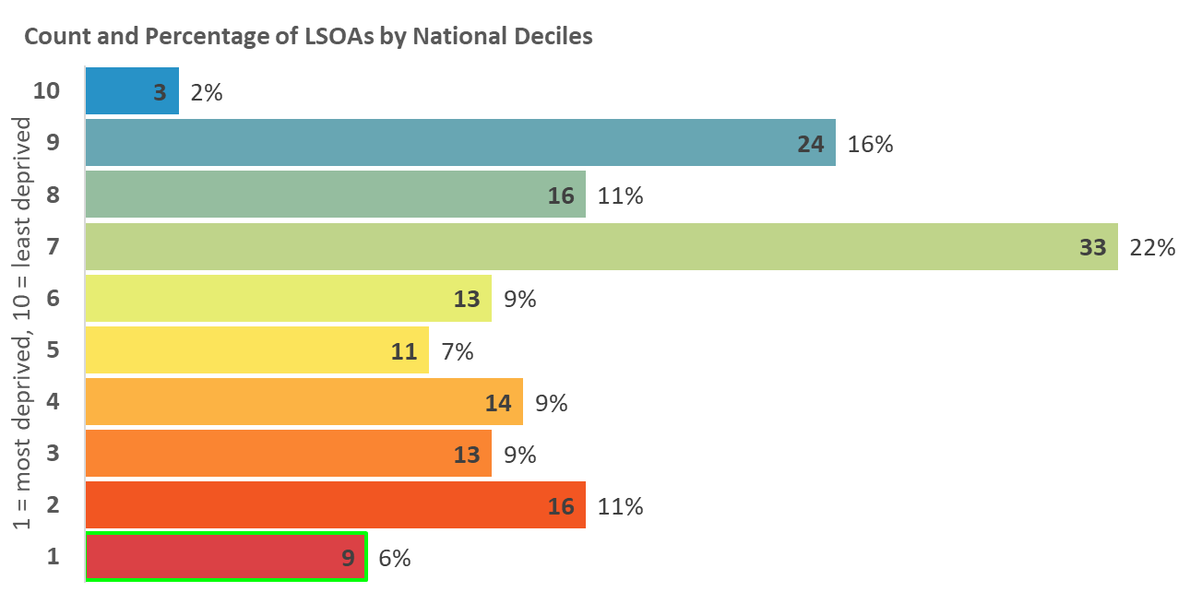
Indices of Deprivation 2019
Milton Keynes
Adult Skills Deprivation
Based on two indicators: Adult skills and English language proficiency. Adult skills is the proportion of working age adults with no or low qualifications. English language proficiency is the proportion of working age adults who cannot speak English or cannot speak English well.
Map 8: Distribution of Adult Skills Deprivation 2019
Areas amongst the most deprived 20% in England
2015
2019
Legend
10% most deprived
20% most deprived

Slide 12
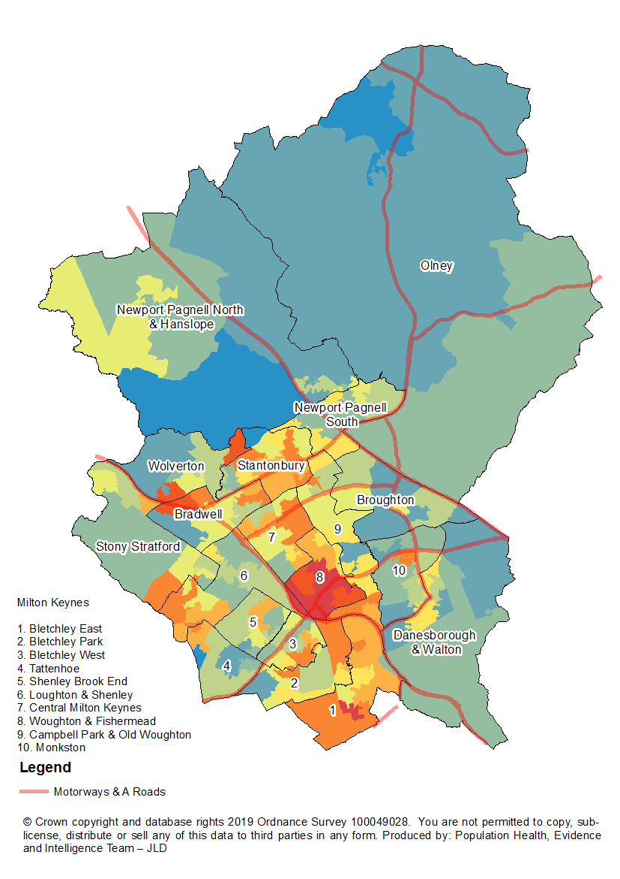
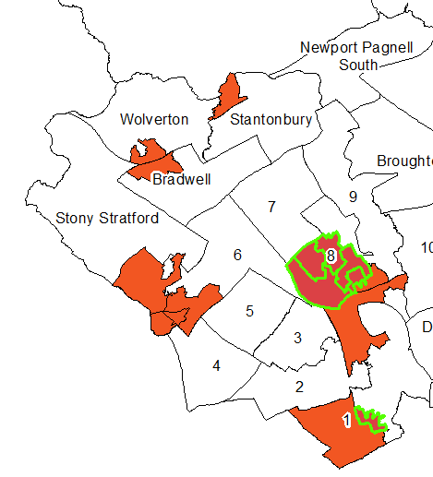
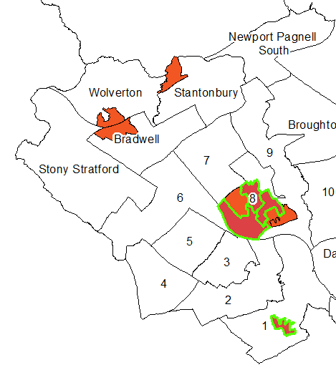
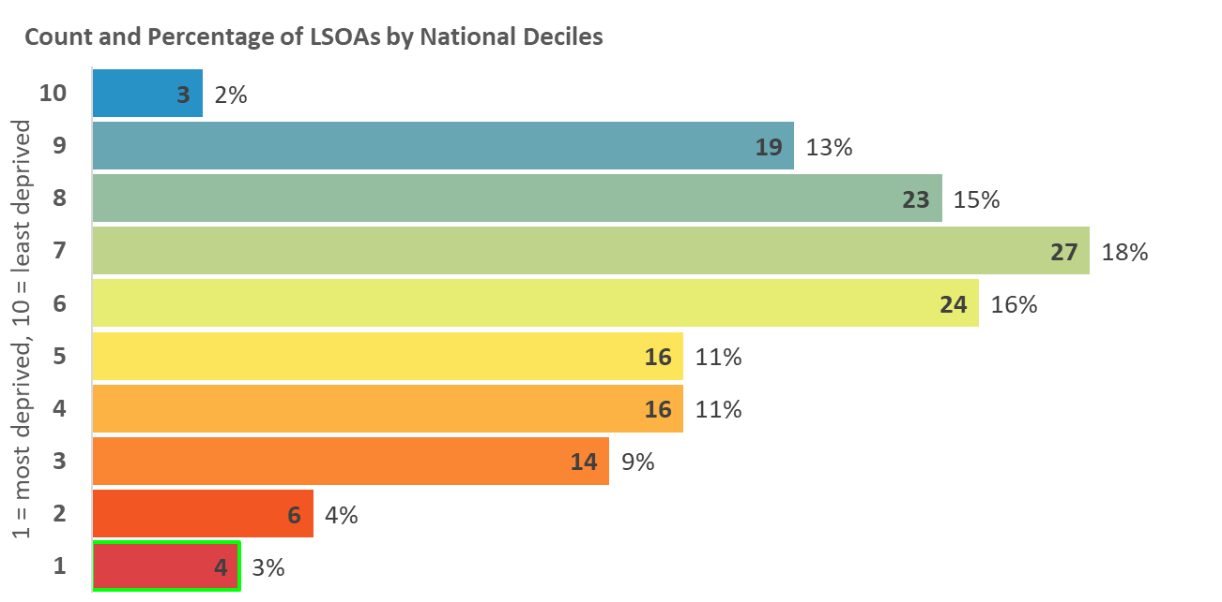
Indices of Deprivation 2019
Milton Keynes
Health Deprivation and Disability
Deprivation
Measures the risk of premature death and the impairment of quality of life through poor physical or mental health. The domain measures morbidity, disability and premature mortality but not aspects of behaviour or environment that may be predictive of future health deprivation.
Map 9: Distribution of Health and Disability Deprivation 2019
Areas amongst the most deprived 20% in England
2015
2019
Legend
10% most deprived
20% most deprived

Slide 13
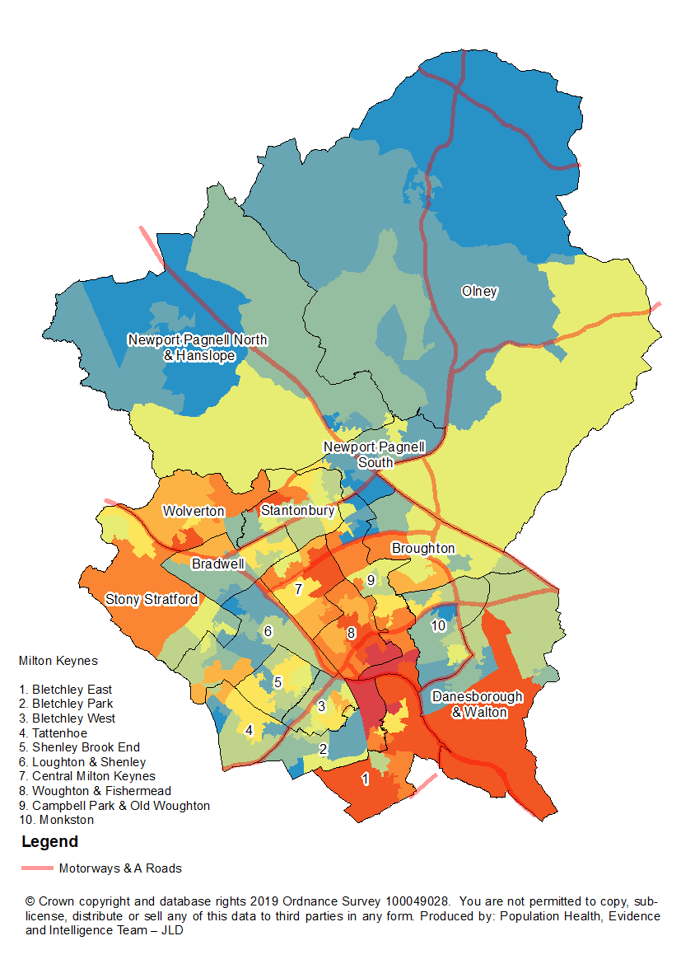
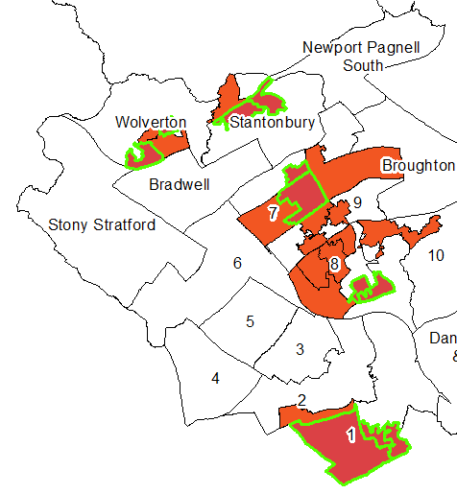
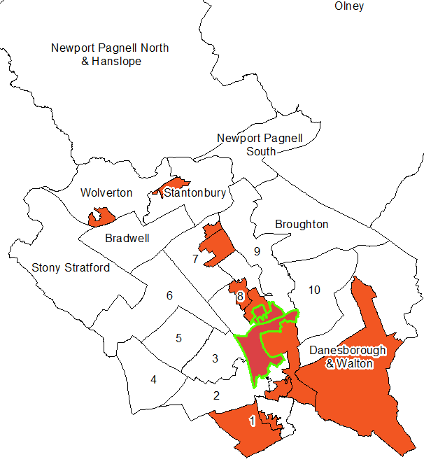
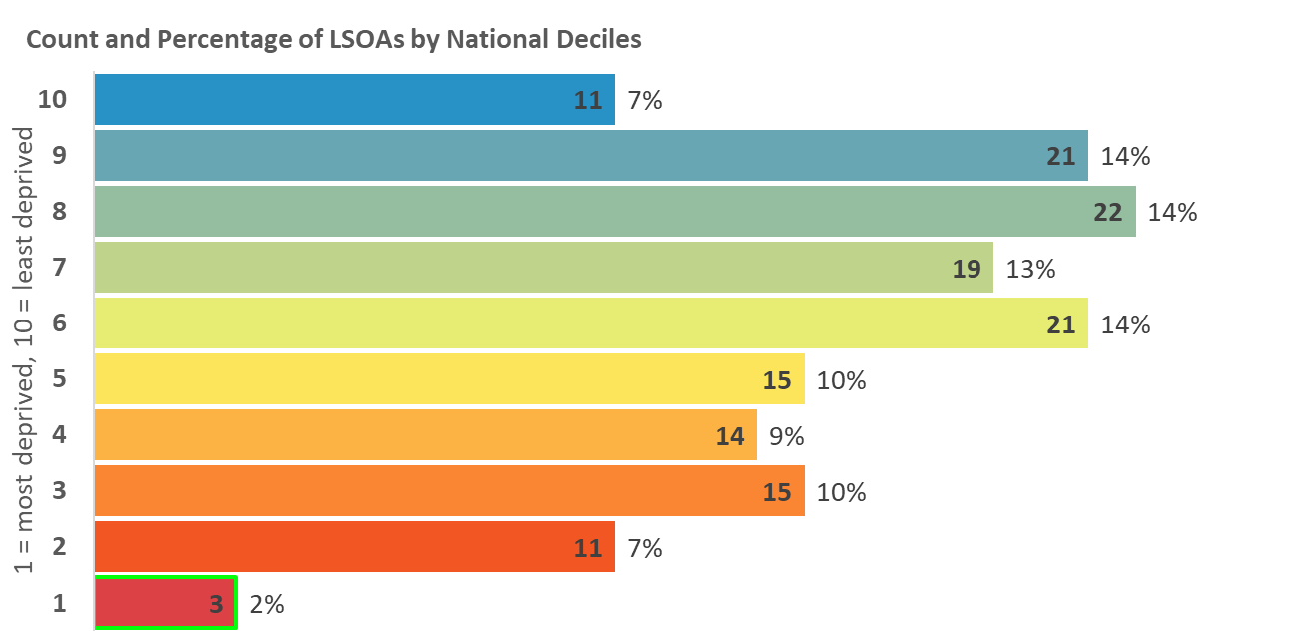
Indices of Deprivation 2019
Milton Keynes
Crime Deprivation
Measures the risk of personal and material victimisation at local level. Based on the numbers of reported crime types relating to violence, burglary, theft, and criminal damage.
Map 10: Distribution of Crime Deprivation 2019
Areas amongst the most deprived 20% in England
2015
2019
Legend
10% most deprived
20% most deprived

Slide 14
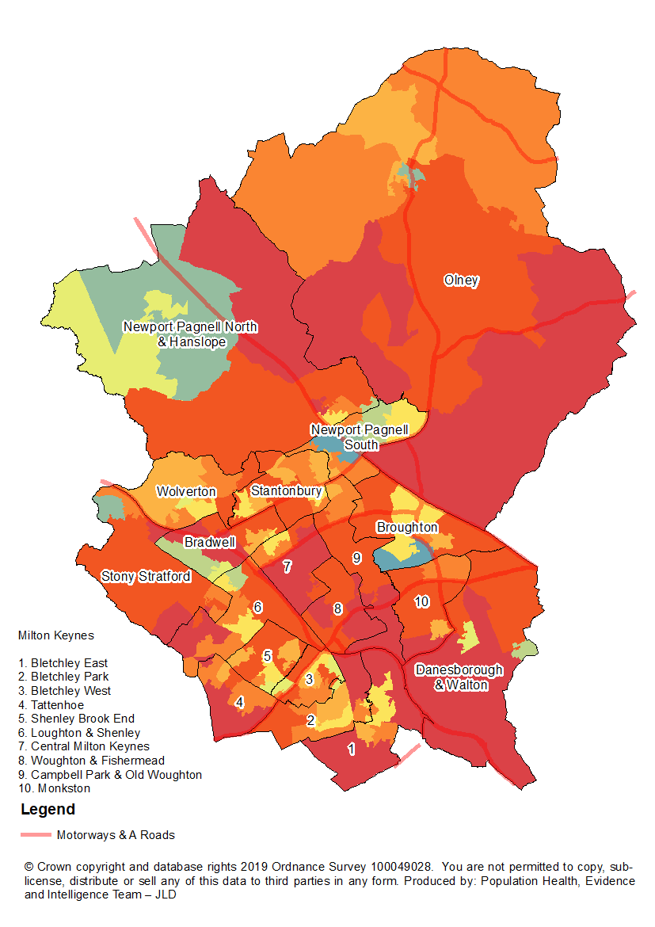
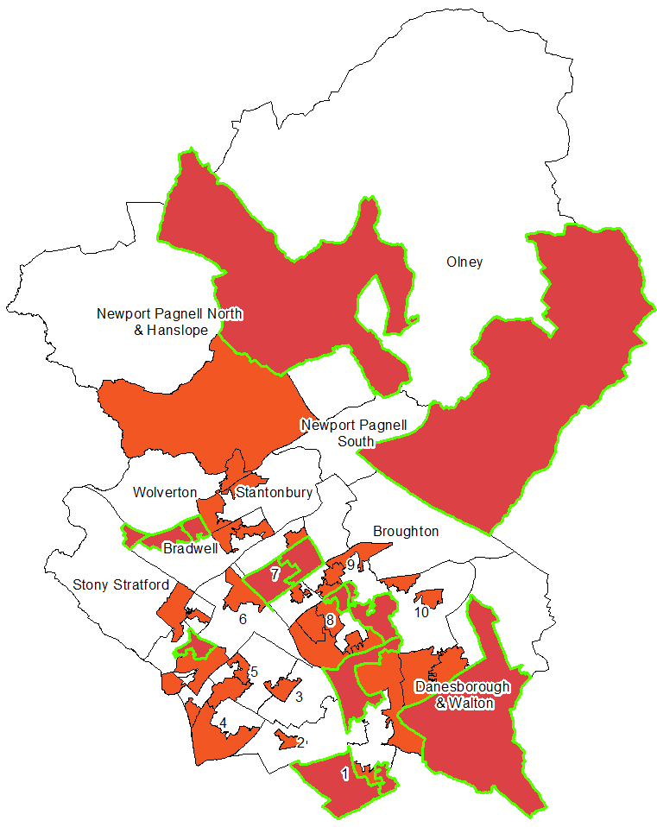
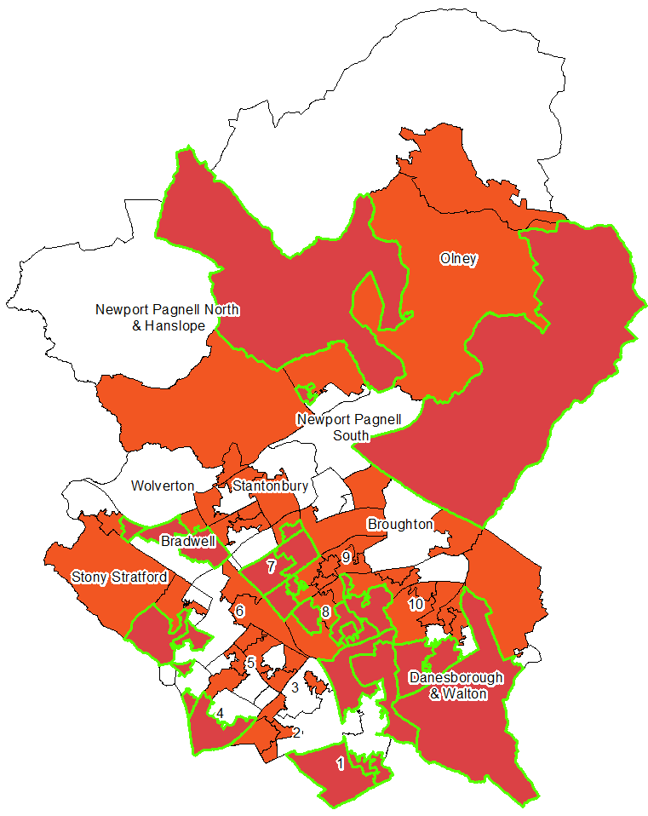
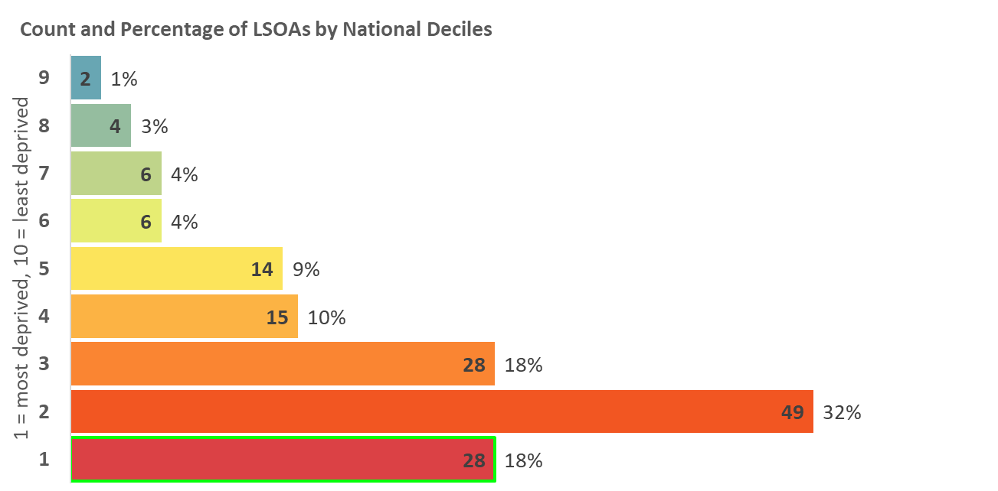
Indices of Deprivation 2019
Milton Keynes
Barriers to Housing and
Services Deprivation
Measures the physical and financial accessibility of housing and key local services. The indicators falls into two sub-domains: ‘geographical barriers’, which relate to the physical proximity of local services, and ‘wider barriers’ which includes issues relating to access to housing i.e. affordability.
Map 11: Distribution of Barriers to Housing and Services
Deprivation 2019
Areas amongst the most deprived 20% in England
2015
2019
Legend
10% most deprived
20% most deprived

Slide 15
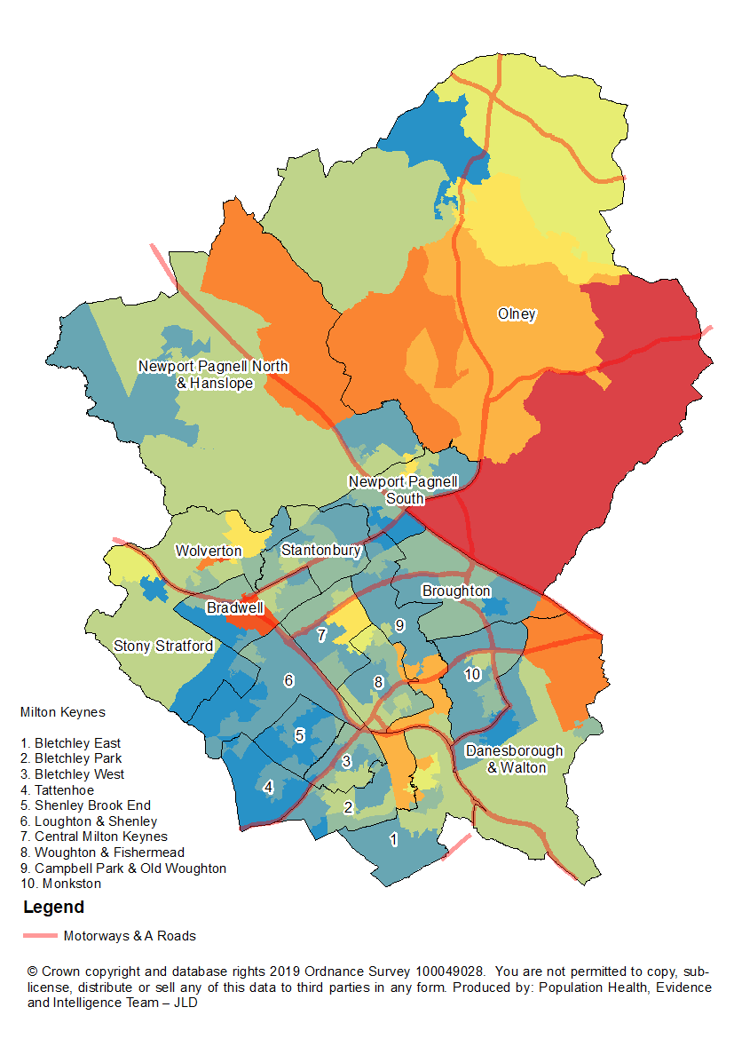
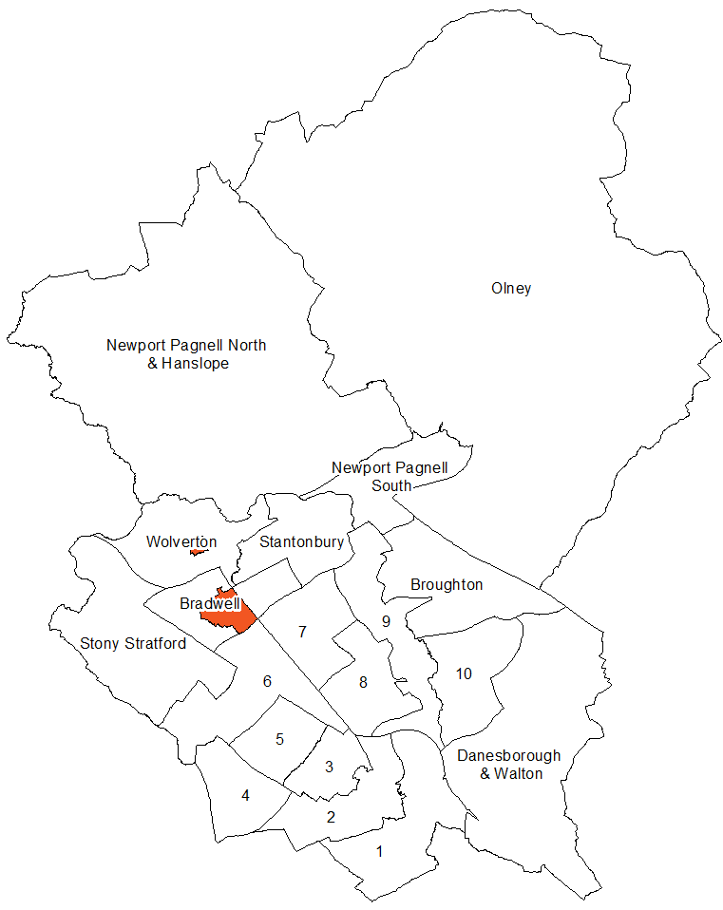
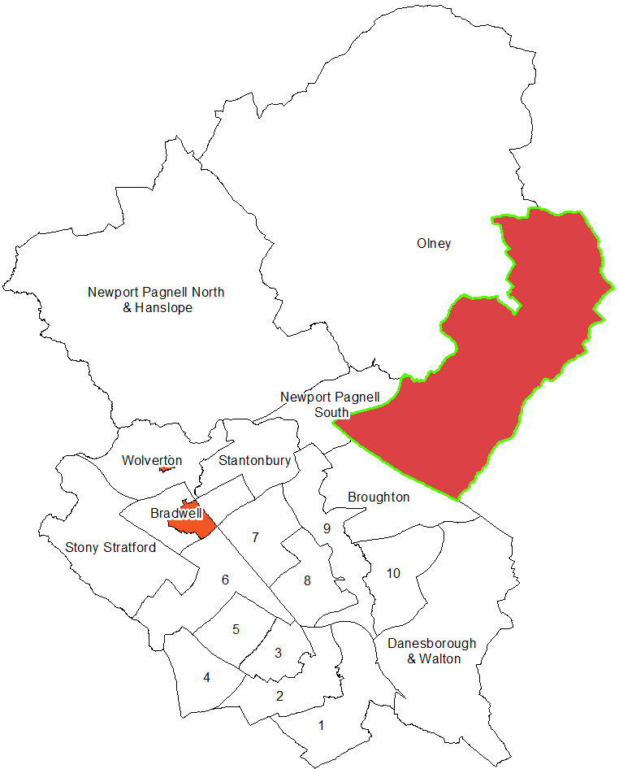
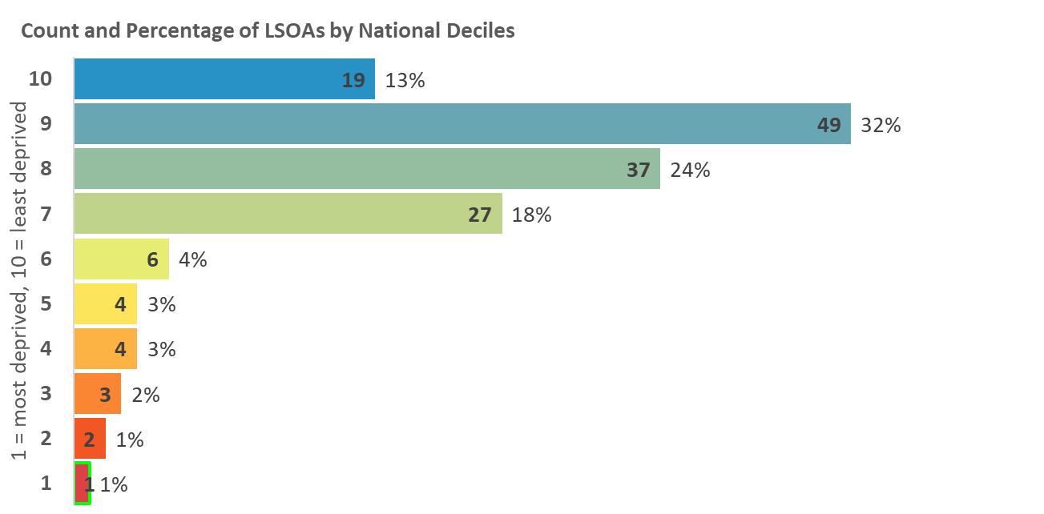
Indices of Deprivation 2019
Milton Keynes
Living Environment
Deprivation
Measures the quality of the local environment. The indicator falls into two sub-domains. The ‘indoors’ living environment measures the quality of housing; while the ‘outdoors’ living environment contains measures of air quality and road traffic accidents.
Map 12: Distribution of Living Environment Deprivation 2019
Areas amongst the most deprived 20% in England
2015
2019
Legend
10% most deprived
20% most deprived

Slide 16
Indices of Deprivation 2019
Milton Keynes
Figure 2: Location by ward of the top 5 most deprived LSOAs
Ward | Overall | Income | Employment | Income deprivation affecting older people | Income deprivation affecting children | Education skills and training | Children and young people | Crime | Barriers to housing and services | Living environment | Adult skills | Health Deprivation and Disability
Bletchley East | ü | ü | ü | ü | ü |  |  | ü | ü |  | ü | ü
Bletchley Park
Bletchley West
Bradwell |  |  |  |  |  |  |  |  |  | ü
Broughton
Campbell Park & Old Woughton |  |  |  |  |  |  |  | ü
Central Milton Keynes |  |  |  |  |  |  |  |  | ü
Danesborough & Walton
Loughton & Shenley
Monkston
Newport Pagnell North & Hanslope |  |  |  |  |  |  |  |  |  | ü
Newport Pagnell South
Olney |  |  |  |  |  |  |  |  | ü | ü
Shenley Brook End
Stantonbury
Stony Stratford |  |  |  |  |  | ü | ü |  | ü |  | ü
Tattenhoe |  |  |  | ü
Wolverton |  |  |  |  |  |  |  |  |  | ü
Woughton & Fishermead | ü | ü | ü | ü | ü | ü | ü | ü | ü |  | ü | ü

Slide 17
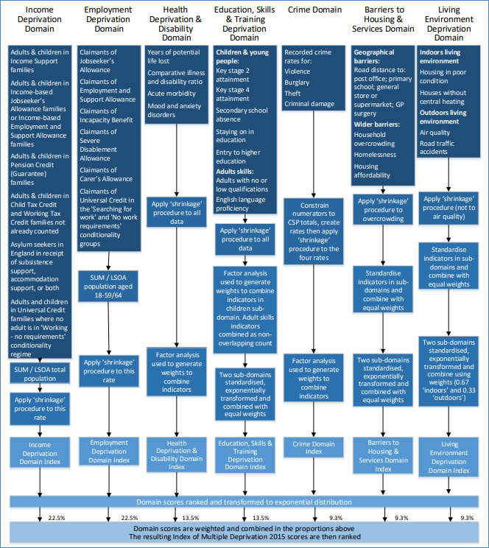
Indices of Deprivation 2019
Milton Keynes
Figure 3: Summary of the domains, indicators and statistical methods used to create the Indices of Deprivation 2019

Slide 18
Indices of Deprivation 2019
Milton Keynes
Further information
The full IoD data along with technical details and national reports can be found here:
https://www.gov.uk/government/statistics/english-indices-of-deprivation-2019
A helpful visualisation tool of the national results can be found here:
http://dclgapps.communities.gov.uk/imd/iod_index.html

