Slide 1
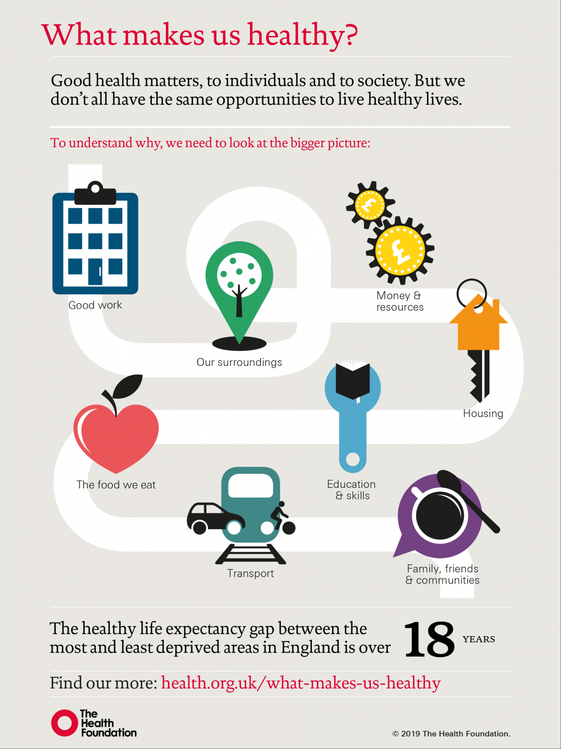
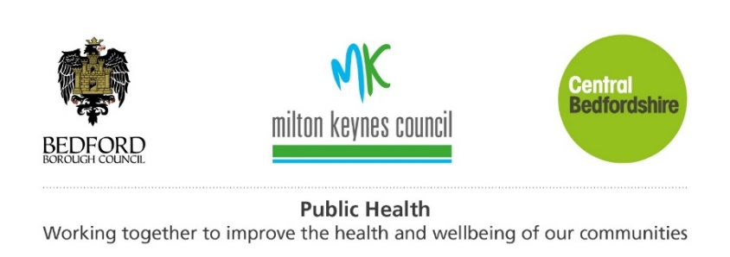
Health and Wellbeing in Milton Keynes, July 2019
What makes our population healthy?
How good are our population health outcomes?
Vicky Head, Chief Officer for Population Health Intelligence
Emmeline Watkins, Deputy Director of Public Heath, Milton Keynes Council
With thanks to What Makes Us Healthy?

Slide 2
Milton Keynes Health and Wellbeing Strategy, 2018-2028
Progress against the HWB strategy priorities has been provided quarterly with routine reporting by exception. A full review of performance measures is presented to the Health and Wellbeing Board on an annual basis.
In the 2019 Long Term Plan, NHS England sets out the importance of taking a population health approach. This aims to improve the health of an entire population.
A population health approach means:
  improving physical and mental health outcomes and wellbeing;
  reducing health inequalities within and across populations;
  actions to reduce the occurrence of ill-health, including addressing the wider determinants of health;
  working with communities and partner agencies.
This report presents a high level view of key population health determinants and outcomes for MK residents. The full list of performance measures is given in an appendix.

Slide 3
The biggest determinants of our health are where we live, how we live and the social and economic conditions around us.
Estimates suggest these factors account for at least 60% of health outcomes.
How are we doing on these in MK?
11
MK
Source: Buck & Maguire (2015) Inequalities in Life Expectancy, King’s Fund
Adapted, with kind permission, from

Slide 4





Good work
Good work pays fairly and offers security, ensures good working conditions, promotes a good work life balance and provides training and opportunities to progress. People who are well are more likely to be in employment and people who are employed are more likely to be in good health. People in higher status roles are more likely to be healthy and less likely to die of heart disease.
MK has a buoyant economy, but there is scope for the benefits to be enjoyed more fairly:
There are plenty of jobs in MK with 1.15 per person of working age – but our residents earn less than people who work in MK (£588 compared to £622 per week).
4.3% of people are unemployed,
which is similar to the national
average but higher than the
South East average of
3.4%. Unemployment is three
times higher in Woughton than in Olney.
The employment rate gap is:
11
percentage points worse
for people with a long term health condition
percentage points worse
for people with a learning disability
67
percentage points worse
for people in contact with secondary mental health services
73
9,400 households - more than one in ten - have no one in work
13% of jobs in MK
pay less than the Living Wage
Nationally, 16.5% of all people in paid work were employed in the public sector in March 2019

Slide 5




Money and resources
Poverty damages health and poor health increases the risk of poverty. An inadequate income makes it more difficult to avoid stress and feel in control, access experiences and material resources, adopt and maintain healthy behaviours, and feel supported by a financial safety net.
Men and women living in the least deprived parts of MK enjoy over 11 years more in good health than those living in the most deprived areas.
A 2019 analysis by Loughborough University estimates that 31% of children in MK live in poverty, after housing costs are taken into account.
The highest concentrations of income deprivation are found in Woughton and Water Eaton, along with parts of Wolverton and Bradwell wards. Some of these areas are among the 10% most deprived areas in England.
2/3
Nationally,
of child poverty is within working families.

Slide 6








Education and skills
A good education helps build strong foundations for supportive social connections, accessing good work, life-long learning and problem solving, and feeling empowered and valued. By the age of 30, those with the highest levels of education are expected to live four years longer than those with the lowest levels of education.
EYFS: % reaching a good level of development at the end of reception
Year 6: % reaching expected level in reading, writing and maths at Key Stage 2
Secondary school fixed period exclusions (per 100 pupils)
73%
9 per 100
64%
Similar LAs: 8.4%
Similar LAs: 73%
England: 64%
MK children eligible for Free School Meals: 60%
MK Looked After Children: 30%
Year 11: % pupils achieving 9-5 in English and Maths
Post-18: % in sustained education destination
39%
South East: 46%
Adults: % with no/Level 1 qualifications only
MK children eligible for Free School Meals: 19%
63%
19%
Similar LAs: 17%
England: 61%
MK ‘disadvantaged’: 62%
% with no qualifications 4x higher in Water Eaton & Wolverton than Emmerson Valley & Middleton
% 16-17 year olds not in education, employment or training
4.6%
Similar LAs: 5.2%
Best performing LA: 1.9%

Slide 7






Transport
Transport enables people to access what they need, including jobs, education, social activities and services. A healthy and sustainable transport system supports safe and community-friendly streets and spaces, is accessible and efficient, minimises harmful impacts on the environment and enables walking, cycling and public transport use.
Active travel and public transport are key parts of a healthy transport system:
In MK in 2011:
More people cycling and walking for short journeys
Reduces congestion
Reduces air pollution
Improves physical and mental health
Saves residents money
70%
of people commuting to work drove a car or van
10%
Just
walked or cycled to work
43%
travelled less than 5km to work
Yet
Despite city growth, air quality in Milton Keynes has improved over the last decade, though the downward trend has slowed in the last few years.
Active commuters have a significantly reduced risk of all-cause mortality, cardiovascular disease and diabetes.

Slide 8





Our surroundings
Good surroundings can help people be more physically active, feel safe and secure, use facilities and services, and socialise and play. There is strong evidence to suggest that green spaces have a beneficial impact on physical and mental wellbeing and cognitive function through both physical access and usage.
The 2016 Vital Signs survey found that:
84% of people felt MK is a safe place to live
Just 40% felt safe walking alone
at night
Nearly half felt their neighbourhood was starting to look run down or untidy
Over 30% of the city of Milton Keynes is public open space with at least 3,200 hectares of parkland and green spaces. However, a 2009 survey suggested MK residents were less likely than average to visit the natural environment for health or exercise purposes.
1/5 adults are physically inactive
70%
Targeting these people, who are active for less than 30 minutes per week, has the greatest potential to improve health outcomes.
of MK 15 year-olds are sedentary for over 7 hours a day

Slide 9
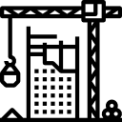



Housing
Housing conditions influence our physical health, mental health and wellbeing. A healthy home is affordable and offers a stable and secure base, is able to provide for all the household’s needs, and is connected to community, work and services.
One in five homes in England doesn’t meet the decent home standard, with a cost to the NHS of at least £1.4billion per year. Children living in crowded homes are more likely to be stressed, anxious and depressed, have poorer physical health and attain less well at school.
MK needs 26,500 new homes between 2016 and 2031. Demand for homes is consistently higher than the delivery of new homes, fuelling price increases.
A stock condition survey in MK in 2016/17 showed that 35% of council homes were non-decent, compared to a national average of 13%.
The cost of buying a home in MK has increased 69% since 2010, compared to 46% across England overall.
There are currently 786 households and 1,320 children in temporary accommodation in MK, an 860% increase from just 82 households in 2010.
Home ownership has dropped by 8% since 2011, with a comparable increase in the number of families renting privately.
30
people were estimated to be sleeping rough in in MK in May this year.

Slide 10

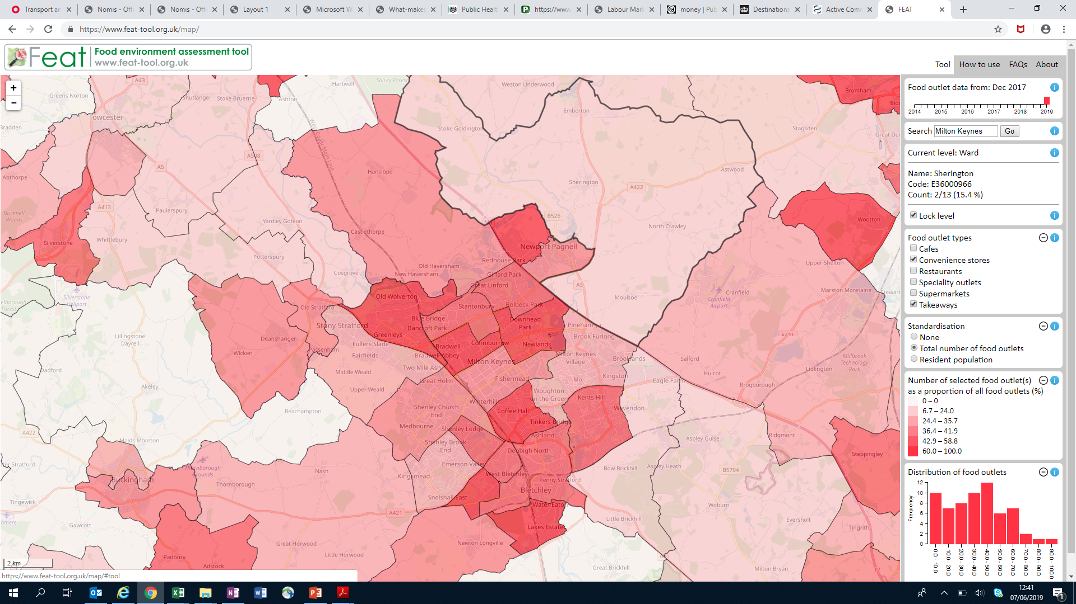
The food we eat
Poor diet is the biggest risk factor for preventable ill health in England. We have an epidemic of obesity but many people experience hunger. Food has never been more widely available, yet many people struggle to access the good food they need for a healthy diet.
It is three times more expensive to get the energy we need from healthy foods than unhealthy foods and it is harder to buy healthy foods in deprived areas.
% food outlets that are convenience stores or takeaways
1/5 Reception children are overweight or obese, rising to
17%
(1 out of 6)
Food poverty is not measured systematically in the UK.
The UN estimates that 10% of adults in the UK experience food insecurity.
There are at least 12 food banks operating in MK.
1/3
of children in Year 6, and
2/3
of adults.
These proportions are similar to comparable LAs.
79%
(22 out of 28)
86%
(6 out of 7)

Slide 11




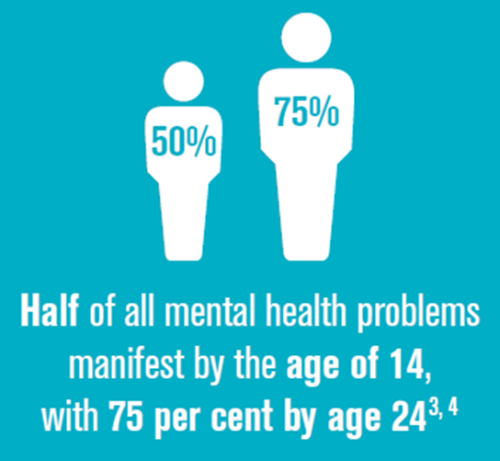
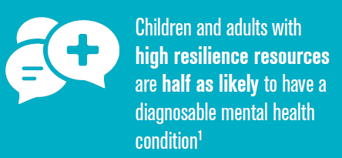

Family, friends and communities
Family, friends and communities build the foundations for good health through: positive relationships and networks; community cohesion and connection; opportunities for social participation; and shared ownership and empowerment.
A lack of social connections is as damaging to our health as smoking
47% of social care service users in MK feel they have as much social contact as they would like.
15
cigarettes a day
40% of adult carers in MK feel they have as much social contact as they would like.
The 2016 Vital Signs Survey found that 75% of people try to get involved with local events and activities.
However:
80% have a sense of belonging
to their neighbourhood, estate or village.
20% of MK adults report that their anxiety is high or very high
The 2014/15 WAY survey of 15 year olds in MK found:
59% reported being bullied, above the national average of 55%,
Self-reported wellbeing was lower than nationally,
Anxiety is the most common reason for referring MK children and young people to CAMHs.
60% reported positive satisfaction with life, compared to 64% nationally.

Slide 12
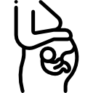
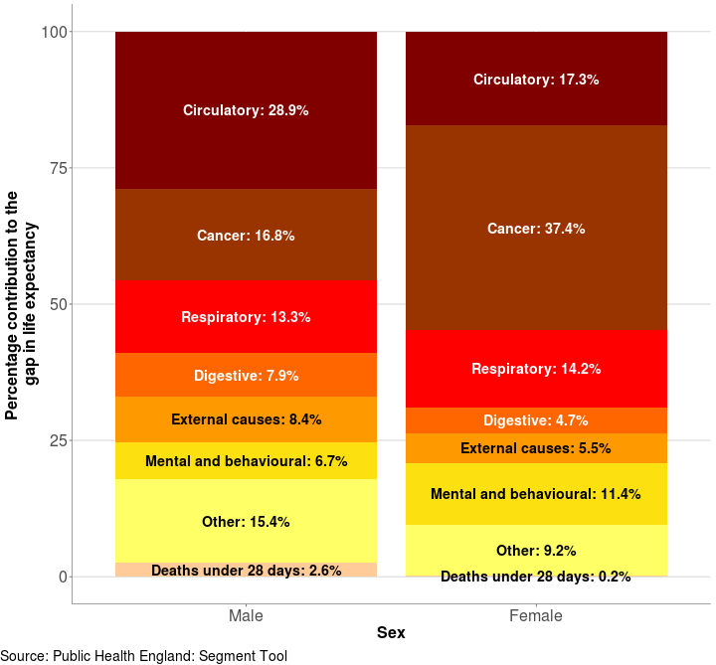

Health outcomes in MK: Life expectancy
A baby boy born in MK today can expect to live for 79.1 years and a baby girl for 83.1 years
Breakdown of the life expectancy gap in MK between most and least deprived deciles by broad cause of death, 2015-17
Babies born in the most affluent parts of MK will live around 7.5 years longer than those born in the most deprived areas. This gap has widened over the last five years for women.
The life expectancy gap is mainly due to higher deaths from circulatory diseases, cancer and respiratory diseases in more deprived areas.

Slide 13
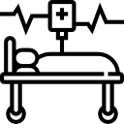




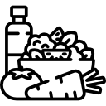




Health outcomes in MK: Mortality
Deaths under the age of 75 in MK are significantly higher than in similar local authorities.
Premature mortality from stroke and cancer are high.
Colorectal cancer premature mortality is particularly high and is rising in MK, compared to a declining trend nationally and in similar areas.
The MK mortality rate from causes considered preventable is declining but remains significantly higher than similar local authorities. Preventable deaths from cancer are particularly high.
Mortality rates from lung cancer and COPD are significantly higher than in similar areas and more years of life are lost to smoking related illnesses. Smoking related admissions are also high.

Slide 14
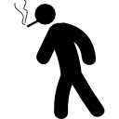






Smoking, respiratory disease and cancer
13%
24%
among those in routine and manual occupations, and
of MK adults are current smokers, rising to
43%
among those with a serious mental health condition.
Compared to similar areas, the cost of smoking related admissions is high and a higher proportion of babies are born at a low birth weight.
Hospital admissions for asthma in <19 year olds and COPD are high.
14% of deaths in MK are caused by respiratory diseases.
30% of deaths in MK are caused by cancer.
Participation in cancer screening programmes is lower than it should be:
Emergency presentations for colorectal cancers are higher than the best 5 similar CCGs
Breast: 76.7% coverage compared to 77% in similar areas
Lung cancer registrations are higher than in similar areas
Cervical: 71.2% coverage, compared to 73.6% in similar areas
Bowel: 56.1% coverage, compared to 60.6% in similar areas
1-year survival from all cancers is lower than nationally

Slide 15



Circulatory disease
23% of deaths in MK are caused by circulatory diseases.
12% of MK patients have recorded high blood pressure. This is lower than average, but a lower proportion have their blood pressure under control.
Among people with diabetes, a higher proportion than average go on to develop complications, including angina, heart failure or stroke.
Coronary heart disease admission rates are higher than nationally.
There are significant opportunities to improve circulatory disease outcomes:
The risk condition
Blood Pressure
Atrial Fibrillation
Diabetes
Stroke / TIA
Chronic Kidney Disease
26,071 undiagnosed
7,859 poorly controlled
1,870 undiagnosed
696 poorly controlled
3,529 undiagnosed
22,182 ‘pre-diabetic’
36% do not receive all 8 care processes
372 poorly controlled blood pressure
4,332
undiagnosed
Opportunities
Reducing BP in all adults with hypertension by 5 mmHg reduces risk of CVD events by 10%
Anti-coagulation of high risk AF patients: averts one stroke in every 25 treated
Decrease in heart attacks, strokes, kidney, eye & nerve damage
Reducing BP in all adults with hypertension by 5 mmHg reduces risk of CVD events by 10%
Decrease in CVD, acute kidney injury & renal replacement
Outcomes

Slide 16
Health and Wellbeing Strategy Performance Measures
Key data sources

Slide 17
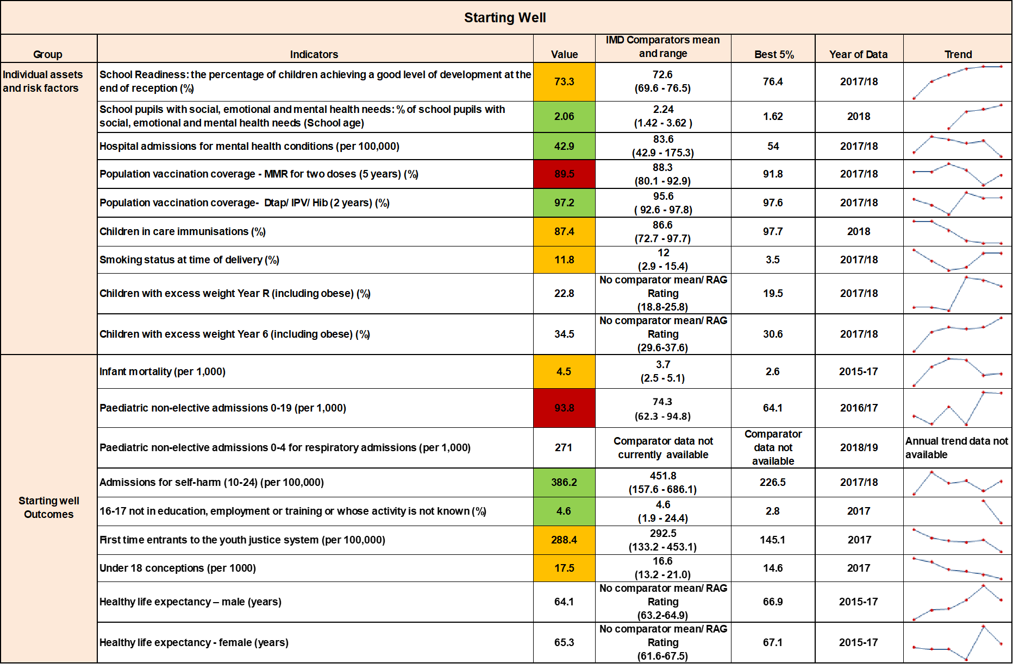

Slide 18
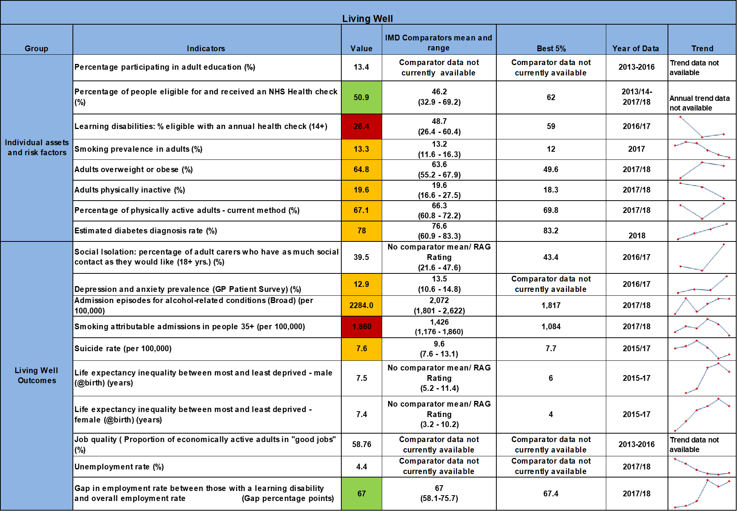

Slide 20
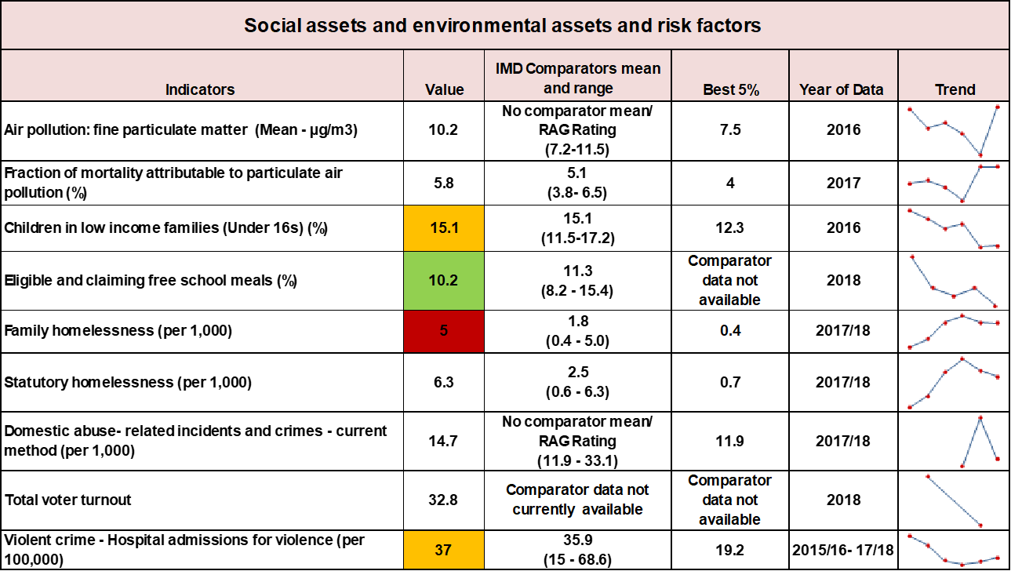

Slide 21
Key data sources
The data in this report are mostly taken from the following sources. A complete list of sources is available on request. The data used are the latest validated and (where relevant) benchmarked data; more up to date local data may be available on some indicators.
Fingertips, Public Health England – wider determinants and health outcomes
NOMIS – economic indicators and Census data
End Child Poverty 2019
Indices of Deprivation 2015
Department for Education and Skills – Educational outcomes
MK 2016 Vital Signs Survey
FEAT Tool December 2017 – Food environment assessment
PHE Segment Tool – mortality and life expectancy gap
NHS Rightcare ‘Where to Look’ cancer and CVD packs
PHE/NHSE Cancer Data Dashboard

